Slide 1

Three-Person
Mechanics
Notes:
This manual should be viewed in conjunction with the 3-person mechanics manual.

Slide 2
Mission of our Mechanics
Mechanics put officials in the best position to make the calls that allow us to keep the game safe and fair by using methods that are easily applied in a consistent manner
Notes:
Remember that safety never takes a holiday.

Slide 3
Pre-Game
coin toss and line up

Slide 4
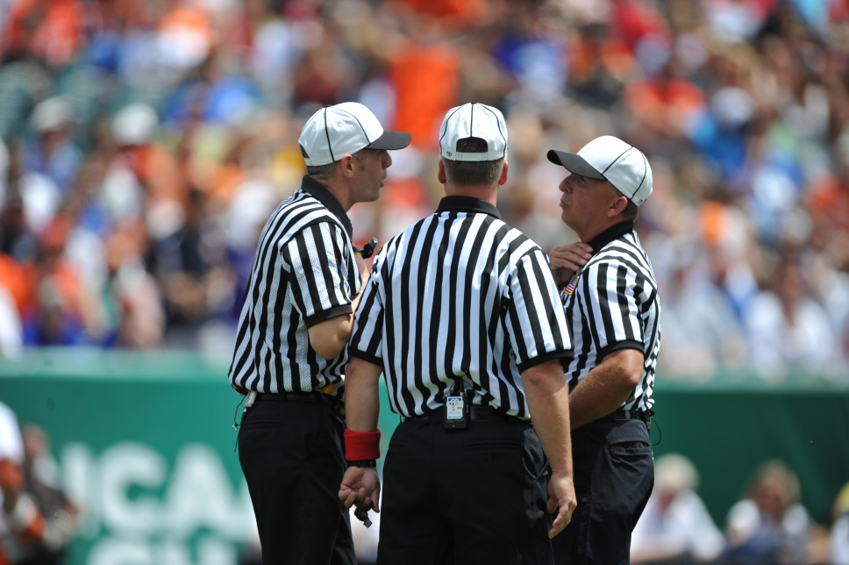
Pre-Game
Referee leads the discussion
Go over the major mechanics
Cover any odd situations
Make sure you’re all wearing the same uniform
Notes:
Referee leads the discussion – This is not a one way street. Each official should contribute to the discussion, but the Referee is in charge.
Go over the major mechanics – A review of the basics is always important, especially if working with partners you have not worked with before or recently.
Cover any odd situations – What did each of you see in the last few games that was confusing? Talk about weird scenarios to better prepare yourself for the game ahead.
Make sure you’re all wearing the same uniform – All officials should match in their officiating attire.

Slide 5
Coin Toss
U
FJ
R
V V
H H H
R
U
FJ
H H H
V V
Speaking captains stand next
to Referee
Manual Page 16
Notes:
Referee stands at Center X:
- Umpire gets the home team captains
- Field Judge gets the visiting team captains
- Umpire leaves a few steps before Field Judge
Referee speaks to the captains:
- Introduces the crew
- Asks captains to introduce each other
- Shows coin to both speaking captains
- Explains coin flip procedure and what to do if coin is dropped
- Asks visiting team speaking captain to choose “heads” or “tails”
- Coin is tossed and caught with open palm
Winning team gets:
- Choice of goal to defend first
- First Alternate Possession (AP)
After the toss:
- Players rotate so their backs are to the goal they will defend first
- Referee taps team that has first AP on the shoulder
- Informs captains to tell their teams when to expect to be called for the line up.

Slide 6
Line Up
M
M
A
W
D
A
D
AAAMMMDDD
G
A
FJ
D
D
A
R
M
M
U
F/O
DDDMMMAAA
D
G
A
D
W
A
M
M
Manual Page 17
Notes:
Referee has the game ball and stands at midfield across from the Umpire and Field Judge on the other side of the field.
Players line up with their left shoulder to the goal they will defend first in order of position: Goalkeeper, Defensemen, Midfielders, Attackmen
Referee gives a few brief words and then instructs the goalkeepers to cross and shake hands, and then the same for the rest of the players.
Referee becomes the face-off official for the first face-off.
Umpire moves to the correct position as the wing official on the bench side, placing one arm into the air to signal that the field is not set.
Field Judge moves to the correct position as the wing official on the far side of the field, placing one arm into the air to signal that the field is not set.
Note 1: The Referee takes the first face-off in the 1st and 4th quarters.
Note 2: The line up is not the time to check player equipment. Make yourself available before the game for any pre-game checks. You should check that the goalkeeper you are standing next to has a mouth guard, throat guard, and chest protector.

Slide 7
Face-Offs
positioning and potential issues

Slide 8
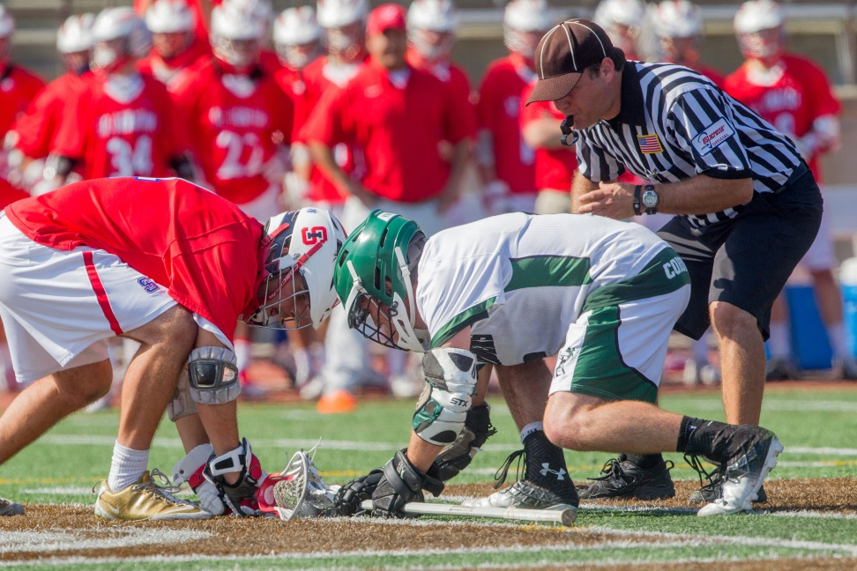
Face-Offs
Officials must communicate
Stay as still as possible
Know the goal you are responsible for
Notes:
Officials must communicate – Do not be in a rush to start the face-off. Look to your partner on the bench side wing line and make sure you are getting the “ready” signal. If you are one of the wing officials make sure your half of the field is set before giving the “ready” signal.
Stay as still as possible – Movement will likely cause one or both of the face-off players to move before your whistle. Get into position first and then go “down,” “set,” TWEET!
Know the goal you are responsible for – To prevent yourself from getting turned around make certain you know the goal you are running to after the face-off ends.

Slide 9
Ball Goes Away From F/O
S
W
F/O
T
L
W
Manual Page 20
Notes:
Face-Off Official
- Places ball on ground and looks to bench side Wing for “ready” signal
- Double checks that both players have their backs to their goalie (facing the correct direction)
- Gives “down” command
- Gives “set” command when players are motionless and settled (players cannot move after set)
- Sounds whistle and focuses on the face-off action
Bench Side Wing Official
- Take a position roughly 5 yards into the field at end of wing line
- Alerts partner of any man-down situation (there is no longer a “hot” player on the wing during a man-down face-off, the wing should be empty)
- Gives “wait” signal while field is not set
- Gives “ready” signal after getting the same signal from the far side wing official
- Watches for wing midfielders leaving too soon and for interference after the whistle
Far Side Wing Official
- Take a position roughly 5 yards into the field at end of wing line
- Gives “wait” signal while field is not set
- Gives “ready” signal to the bench side wing official once field is set
- Watches for wing midfielders leaving too soon and for interference after the whistle
NOTE: The Single has the count once possession is gained. All officials should echo the possession call and then the Single should start the count.

Slide 10
Ball Comes Toward F/O
S
W
F/O
L
W
T
Manual Page 20
Notes:
Face-Off Official
- Places ball on ground and looks to bench side Wing for “ready” signal
- Double checks that both players have their backs to their goalie (facing the correct direction)
- Gives “down” command
- Gives “set” command when players are motionless and settled (players cannot move after set)
- Sounds whistle and focuses on the face-off action
NOTE: The Face-Off official must work to stay outside of the developing play. Keep your eyes on the play while getting to position.
Wing Official
- Take a position roughly 5 yards into the field at end of wing line
- Alerts partner of any man-down situation (there is no longer a “hot” player on the wing during a man-down face-off, the wing should be empty)
- Gives “wait” signal while field is not set
- Gives “ready” signal when field is set
- Watches for wing midfielders leaving too soon and for interference after the whistle
NOTE: The Trail official (W on this slide) has the initial count after possession - whether 10 or 20 (NFHS) or 30 (NCAA). This allows the Lead official to get to the goal without worrying about the count.
Bench Side Wing Official
- Take a position roughly 5 yards into the field at end of wing line
- Alerts partner of any man-down situation (there is no longer a “hot” player on the wing during a man-down face-off, the wing should be empty)
- Gives “wait” signal while field is not set
- Gives “ready” signal after getting the same signal from the far side wing official
- Watches for wing midfielders leaving too soon and for interference after the whistle
Far Side Wing Official
- Take a position roughly 5 yards into the field at end of wing line
- Gives “wait” signal while field is not set
- Gives “ready” signal to the bench side wing official once field is set
- Watches for wing midfielders leaving too soon and for interference after the whistle
NOTE: The Single has the count once possession is gained. All officials should echo the possession call and then the Single should start the count.

Slide 11
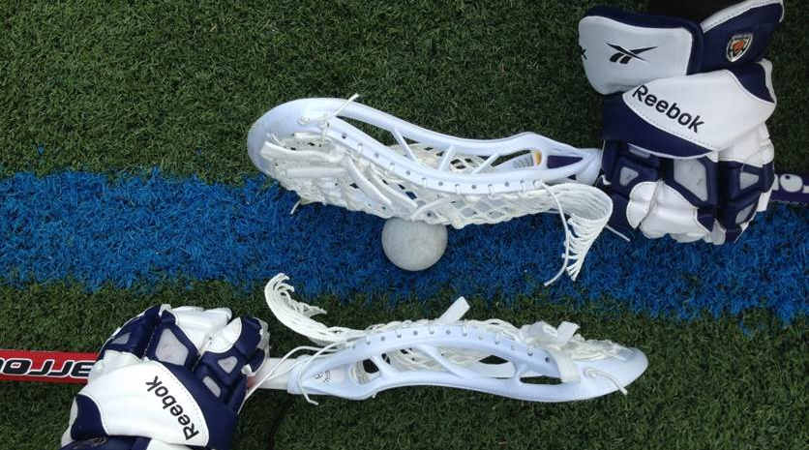
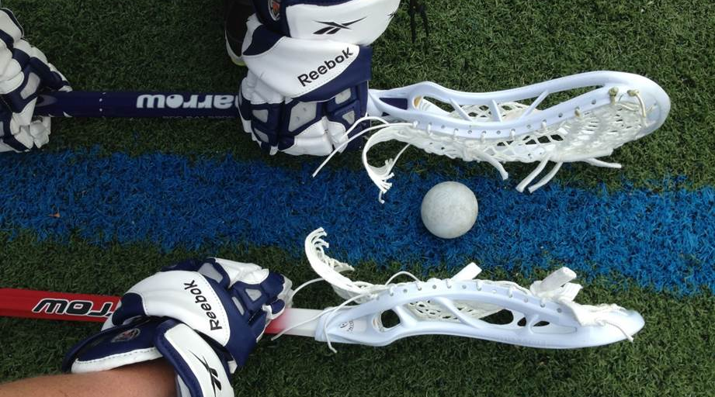
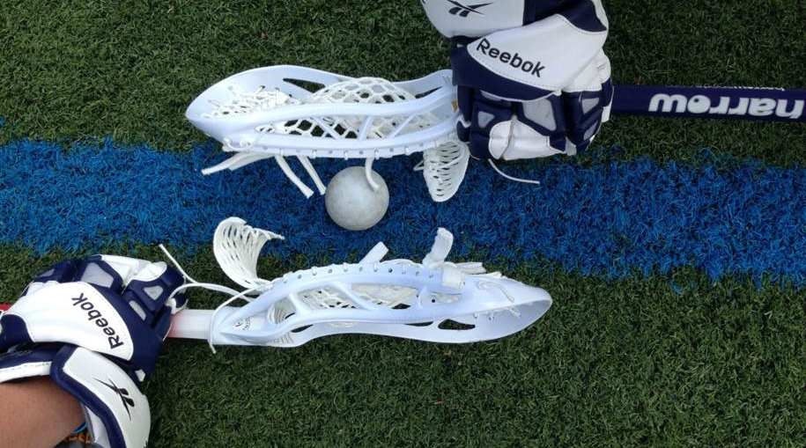
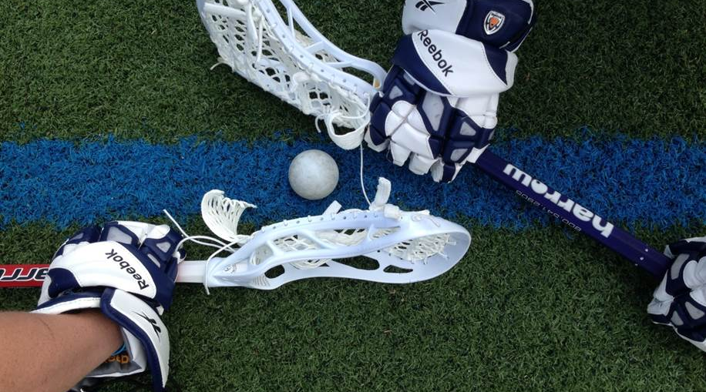
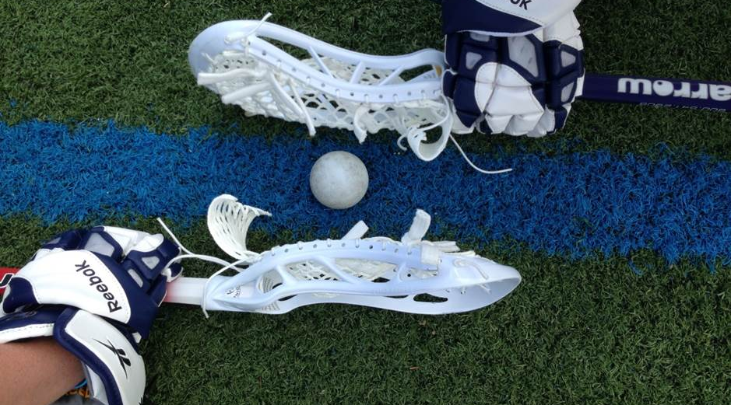
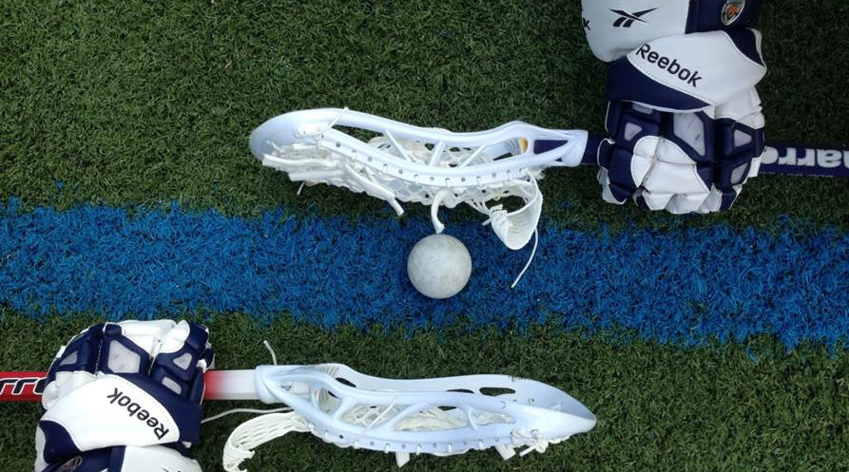
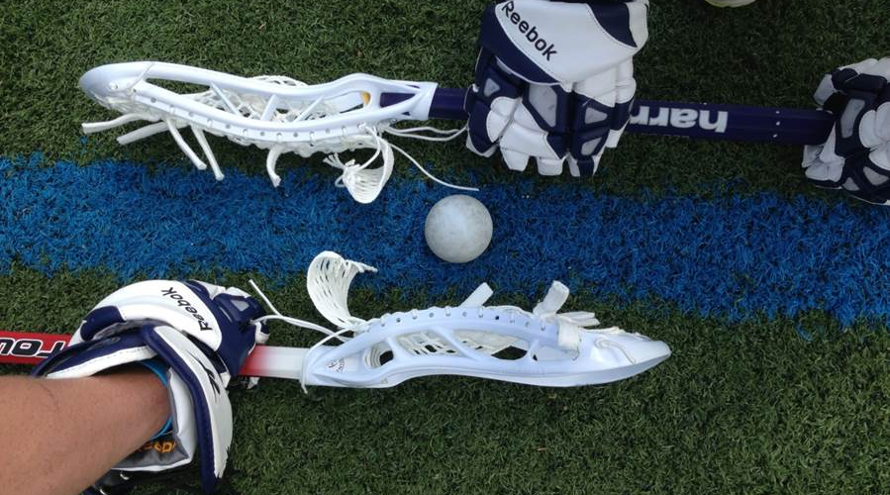
Incorrect Face-Off Positions
Notes:
All of these images show a different illegal face-off position. At lower levels of play it may be permissible to tell the players what to fix if they are lined up incorrectly. At higher levels of play you should not spend an excessive amount of time correcting the positioning. Stand the players up and turn the ball over to the opposing team. Inform the coach what the problem was if he asks at the next available opportunity.
Image 1 – Players cannot face-off left-handed
Historical note – the reason for this is because when the lacrosse rules were standardized in 1867 the crosses used back then only had one sidewall on the right side of the crosse. In order to face-off the players had to do so right-handed.
Image 2 – Hand on plastic and head of crosse leaning over the ball
- Leaning the head of the crosse over the ball is a significant advantage as there is less distance for the player leaning to get to the ball.
Image 3 – Hand on plastic and crosse is not lined up parallel to the center line
- The advantage here is that the player can more easily force his body into his opponent when not lined up evenly.
Image 4 – Hand on plastic
- The advantage here is that the hand on the plastic is closer to the ball, and requires less space to move the crosse forward, and there is a greater chance the player can use his fingers to grab or direct the ball.
Image 5 – Bottom crosse is does not have the back of the head facing the ball
- Simply an illegal position. The back of the crosse should face the ball with no strings or parts of the pocket touching the ball or center line.
Image 6 – Head of crosse is not centered on the ball
- When the crosses are not lined up the one off the ball has a greater advantage when using speed moves like pushing the ball down the line, or hopping the ball to block the opponent’s clamp.
Image 7 – Crosse is touching the ball
- Immediate turnover. Touching the ball might move the ball and the crosse must also touch the line if this happens. Resetting the ball takes too much time.

Slide 12
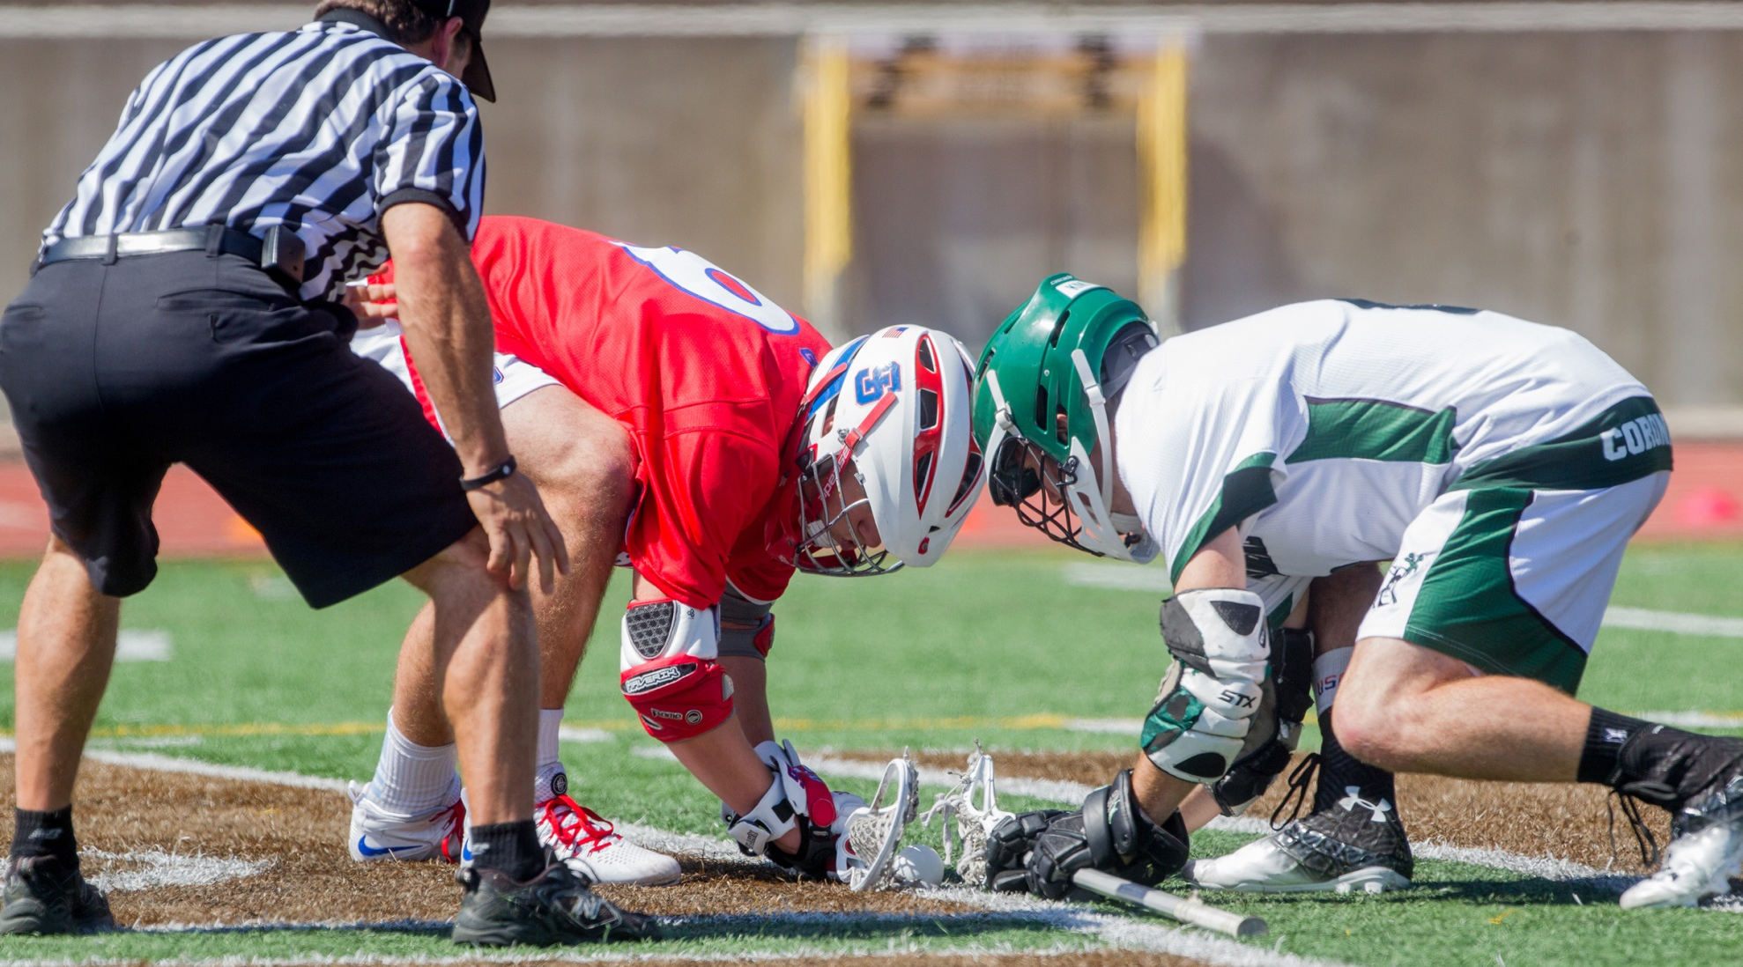
Leaning Crosse Over Ball
Notice the difference between the two crosses. White’s crosse is straight, but Red’s crosse is learning over the ball giving the player an advantage.
Notes:
Note – set yourself up in a position that is most comfortable for you to officiate the face-off.

Slide 13
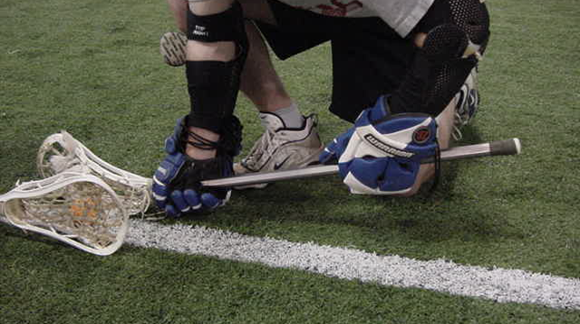
Hand Off The Ground
The fingers of both hands should wrap all the way around the crosse and touch the ground.
Notes:
Depending on where the Face-Off official is positioned, he may not be able to see a player’s hand or hands off the ground. The Wing official with the best view should make this call as it is an illegal position for a face-off.
Face-off players must also:
- Have their sticks parallel to the line and not touching the line
- Sticks vertical and not leaning over the ball or line
- Entire body to the left of the throat of their crosse
- Helmet not leaning over the ball (may lean over the line)

Slide 14
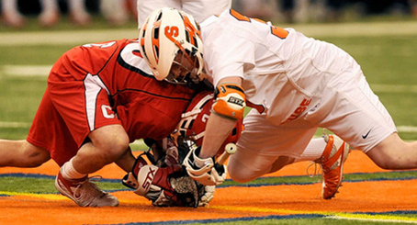
Holding
Notice the Red player’s helmet pressing down into the White player’s crosse.
Notes:
While this is a loose-ball foul, any face-off violation should be whistled dead quickly and play restarted with the offending team in possession.
Trainer Note: This can be demonstrated in class with a second trainer, gloves, and two crosses.

Slide 15
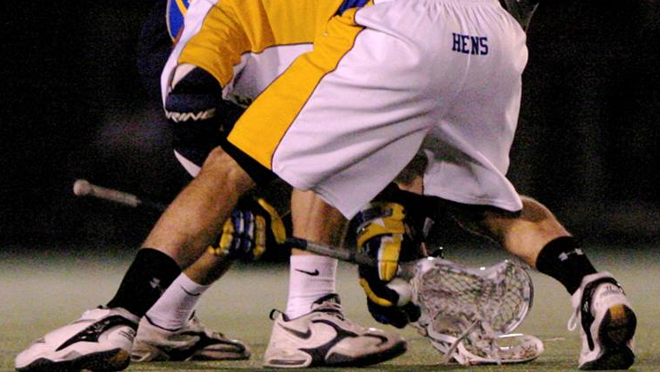
Withholding
Very difficult to spot depending on where you stand. Vary your position if you suspect a player is attempting to grab the ball.
Notes:
The penalty for deliberately using the hands on the face-off is a one-minute, non-releasable unsportsmanlike conduct penalty.

Slide 16
Bring The Wings In
W
F/O
W
Notes:
If you suspect one or both face-off players is attempting to gain an advantage with illegal positioning or techniques and you cannot see it from your vantage point, bring the wing officials further into the field.
Use the field lines to your advantage when determining how far to come in to help the face-off official. If there is a soccer circle come up to that line, but no further to give yourself plenty of room.
The wing officials should set up so they can see through the face-off over to the wing line on the opposite site of the field. This permits all sets of eyes on the face off, and then the two wing officials can keep the opposite wing in their peripheral vision.
NOTE: If your wing has two players jostling for position, keep your eyes on those players as one may leave early or interfere with the other player after the whistle.

Slide 17
Settled situations
triangle coverage and different responsibilities

Slide 18
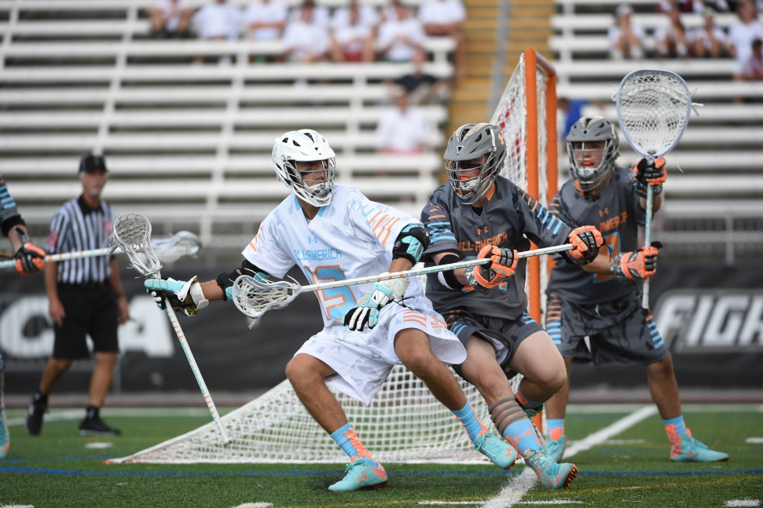
Settled Situations
Keep the ball between you and your partners
Never let the play get behind you
Notes:
Keep the ball between you and your partners – There is a wide triangle framed by each official during play. The movement of the play and the movement of your partners will determine where you move and what your responsibilities are.
Never let the play get behind you – Also known as “light housing”. This is when you have to spin in a circle because you either go too close to a play or did not an anticipate a play coming towards you soon enough. Be aware of the action and remember you can back out beyond the field lines if necessary to keep the play in front of you.

Slide 19
Lead, Trail, and Single
Lead has goal and end line coverage
Single and Trail have the shooter
Trail moves into box and Single covers goal if Lead goes down to cover end line
S
A
L
T
Single and Trail watch the shooter!
This cannot be overemphasized!
Manual Page 21
Notes:
The Lead Official:
- Goal is primary responsibility
- Positioned one yard above or below GLE and should move off to cover the end line on contested plays
- Get as close to the crease as possible without interfering with play
The Single Official
- Primary responsibility is the action in front of the crease
- Also watches for late hits after a shot if not helping the Lead on close crease plays
- Responsible for far sideline and all transition counts
- Positioned a few yards above GLE and should move down to GLE if the Lead official goes to cover the end line
The Trail Official
- Watches the shooter for late hits after a shot
- Moves in towards the box if the Lead official moves to the end line
- Watches the high crease area, especially one on one midfield play and picks above the crease
- Watches for contested substitutions
- Is responsible for covering the far goal on a long outlet pass
NOTE: The pre-game should be clear on each responsibility, but the most important is that the Trail official watches the shooter on every shot.

Slide 20
Close Crease Plays
Lead and Single work in tandem
  Player moves towards
    Watch feet
  Player moves away
    Watch body
S
S
Watches Feet
A
Watches Body
Watches Feet
T
L
Watches Body
A
Trail is always responsible for watching the shooter!
Important when Single and Lead are focused
on the crease.
L
Notes:
Lead and Single:
- Player running at you
- Watch the feet. You have a better view of the feet and the crease when the play is coming at you
- Player running away from you
- Watch the body. You have a better view of the players converging on the player running away from you.
Sell the call!
- If you have a crease violation or a push into the crease you need to sell the call. Let everyone know exactly what your call is.
Close goals:
- Lead official has the whistle when covering the goal, but should always look to the Single for a quick nod to make sure the goal is good before signaling.

Slide 21
On and Off Responsibility
ON
On official watches:
  Area around ball
  Push, hold, trip, illegal body check, warding, etc.
Off officials watch:
  Area away from the ball
  Interference, illegal screen, etc.
All officials move to cover the play
S
OFF
OFF
OFF
OFF
L
T
ON
OFF
ON
OFF
Manual Page 22
Notes:
The location of the ball determines which official is the On official and which are the Off officials. On and Off responsibilities can change multiple times during settled play.
On Official:
Has a narrow focus that is on the player in possession and surrounding 5 yards.
Generally watches for on-ball fouls likes pushing, holding, tripping, illegal body checks, unnecessary roughness, slashing, and warding.
Off Official:
Has a wider view of the play because off ball involves more players in a greater space.
Generally watches for off-ball fouls like interference, illegal offensive screens, and crease violations (cutters running through the crease), and late hits after passes.
All Officials:
The officials must move as if they are connected together. As one moves out, the other moves in. This is especially important on contested plays near the end line.
NOTE: The pre-game should be clear on how On/Off calls will be communicated, especially in the transition area between the officials. Typically, if a player is running towards you then you are about to be the On Official.

Slide 22


Goal Scored
Lead sounds whistle and runs in. Faces action and signals goal
  Trail and Single watch shooter!
Single comes in and watches the players while the Lead gets the ball
Officials exchange the ball while Trail keeps eyes on players
Jog to positions for the next face-off
S
W
F/O
A
T
L
W
The few seconds after a goal is scored is when things
can get out of control if not paying attention.
Manual Page 25
Notes:
The Lead Official:
- Sounds whistle once noticing that the entire ball has crossed the entire goal line
- Runs in and faces action. Stops and signals goal for a few seconds
- Retrieves ball from net (DO NOT ask the goalkeeper to get the ball for you)
- Hands ball to Single official above the crease
- Jogs to position and gets ready for next face
The Single Official:
- Waits for the whistle and goal signal by the Lead and keeps eye on shooter and crease area for late hits
- Moves into the field while Lead gets the ball and keeps eyes on dead ball action
- Retrieves ball from the Lead official and jogs to Center X for the next face-off
The Trail Official:
- Waits for the whistle while watching the shooter and crease area for any late hits or other fouls
- Keeps eyes on dead ball action while Lead and Single exchange the ball
- Jogs to position and gets ready for next face
NOTE: Single should step over midfield to take the face-off to face the goal that was just scored. This way you can see both wing officials and when they are ready.
NOTE: Do not catch the ball with your hat or one-hop the ball to your partner. It does not look professional. Either hand the ball or give a short toss.
NOTE: The exchange is a chance for officials to communicate and make in-game adjustments.

Slide 23
Restarts
stopping and starting play

Slide 24
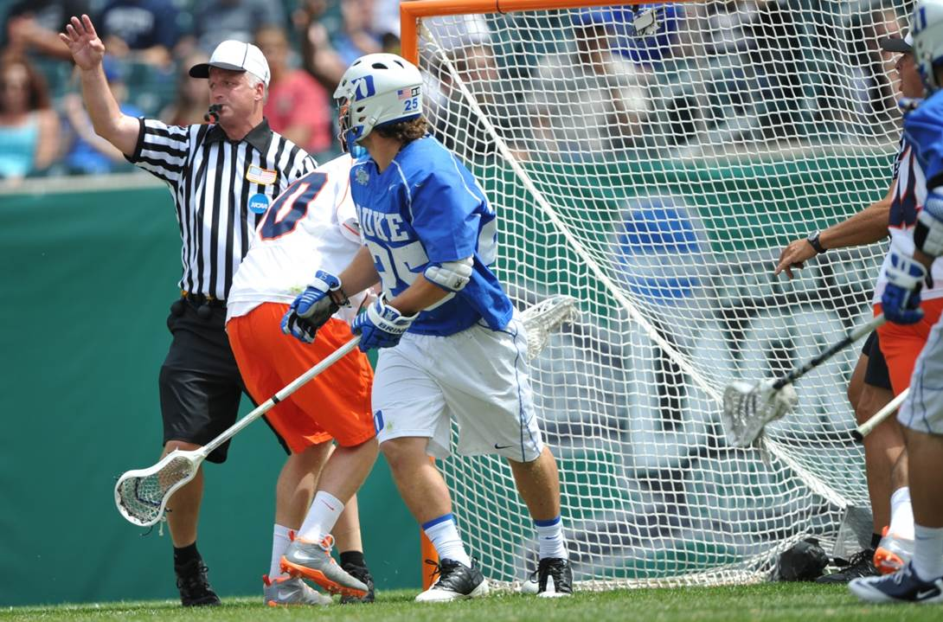
Restarts
Know the lines you are responsible for
Eye contact with partner
Single is the quarterback
Notes:
Know the lines you are responsible for: Blowing the whistle for out of bounds and restarts when you are supposed to is the mark of an official paying attention and leads to a smoother game for both teams and your partners. Know the lines you are responsible for.
Eye contact with partners: The game is speeding up, but officials cannot be in a rush even on quick restarts. Always make eye contact with your partners on slow restarts to make sure you are getting a “ready” signal. On quick restarts when the “ready” signal is not necessary you should still make eye contact with your partners to double check that they are in position and are ready for the next restart.
Single is the quarterback: If the Trail or Lead official has the whistle on a slow restart the Single gives the final “ready” signal. That way the official blowing the whistle knows the entire crew is ready even if he doesn’t have eyes-on his other partner. This is a lot of responsibility on the Single! Don’t just give a “ready” signal – make sure your partner across from you is signaling “ready.”

Slide 25
Out of Bounds Responsibility
SINGLE
TRAIL
LEAD
Manual Page 24
Notes:
The Lead (green):
- Responsible for the entire end line
The Single (blue):
- Responsible for the far sideline
The Trail (red):
- Responsible for bench sideline
- Responsible for end line on opposite side of field when the Lead official
Overlap Areas (purple):
1. Below GLE on the bench sideline the Lead might blow the ball out of bounds, especially if following a contested play. The Trail should be close to the sideline to assist if needed.
2. Far corner of the field. The Lead might make the sideline call if the Single is not in position. Single might make the end line call if Lead is out of position.
Signaling Out of Bounds:
1. Sound whistle while simultaneously signaling “dead ball” with one arm in the air (open palm)
- Sweep the line with one arm if a player touched the side line or end line to indicate the player stepped out if you need to sell the call
2. Signal direction of play and call out the color of the team – “Blue” or “Blue ball!”
3. Place hand back into the air to signal “dead ball”
NOTE: The hand has to go back into the air to show everyone that the ball is still dead, and it puts your arm into the correct position for the restart clock signal.

Slide 26
Sideline
Out of Bounds
  Trail official covers bench sideline
  Single comes in to watch off ball players
Restart
  Lead moves to not interfere with players
  Trail restarts play
S
T
L
Notes:
Out of Bounds:
- The Trail official will blow the ball out of bounds along the bench sideline, unless there is a contested play near the sideline and the Lead has moved out to cover the play.
- Get as close to the line as possible. You won’t get on top of it every time, but the closer you are the more believable your out of bounds call will be. This is especially important on contested plays near the sideline
Slow Restart (After any timeout, after goals, before each quarter):
- Count the players
- Look to partner for ready signal
- Don’t blow through the Stop Sign (“not ready” signal)!
- If one of your partners blows whistle on slow restart and you did not give a “ready” signal, blow your whistle to stop play. Get the field set and then restart play properly.
Quick Restart (After any out of bounds, after a play-on, after a technical foul by the offense):
- Don’t need to count, but should make eye contact with partners
- When settled the official closest to the ball will usually take the restart

Slide 27
End Line
Out of Bounds
  Lead has all end line out of bounds and restarts
  Single should move to cover goal if Lead runs to end line
Restart
  Lead should be in a position to not interfere with the players
  Single covers the goal until Lead is back in position
Trail
  Watches off ball players
S
L
T
Notes:
Out of Bounds:
- The Lead is responsible for the end line the ball goes out on must blow their whistle.
- Get as close to the line as possible. You won’t get on top of it every time, but the closer you are the more believable your out of bounds call will be. This is especially important on contested plays near the end line.
- Single should cover the goal every time the Lead official moves off GLE to cover a contested end line play.
NFHS quick restarts require:
Player in possession and in bounds
Player in possession is stationary
All other players five yards away
NOTE: Keep the ball in front of you at all times, this may require you being out of the field of play when restarting play.
NOTE: If the ball goes out on the far side of the field along the end line it may be best for the Single to take the restart and the Lead to set up on GLE. Especially important during game situations when there is little time left of the clock. Make sure to discuss this with your partners in the pre-game.

Slide 28
Deep Restarts
S
L
L
T
T
Hustle to your position first, and allow
the play to come to you.
Manual Page 24
Notes:
The Single Official:
- Primary responsibility is covering the midline for offside (get to the cone!)
- Has the transition count on the restart
- Quarterbacks the “ready” signal across the field to the Lead and Trail
NOTE: Some Referees prefer the Single to take the restart if the ball goes out of bounds on the far sideline between the restraining lines as that official is usually the closest to the players involved. This should be discussed in the pre-game.
The Trail Official:
- Looks to Single for the “ready” signal if slow restart
- Restarts play and stands in the best position to do so (with the Single helping you out you don’t need to come as far into the field as you might have to in a two-person game)
- Moves up the field with, not ahead of, the ball (in case there is a quick turnover and you need to cover the goal)
- Has the final count for offside after the ball crosses midfield
- Has the 4 second count on the goalie
NOTE: Do not go past the goal for restarts on the far side of the field. Look to your partner for a “ready” signal, even if it is a quick restart as your partner has the better angle on whether the player is in bounds. How the crew will communicate deep restarts should be covered in every pre-game.
The Lead Official:
- Primarily responsible for goal and end line coverage
- Sets an initial position on variety of factors:
- game situation
- team’s tendencies (does one goalie throw the ball up every time, or is the other team more deliberate in their clear?)
- own mobility (if you have trouble keeping up with a fast transition set up farther back)
- Signals when field is ready
- Should be at GLE by the time the ball reaches midfield.
NOTE: The goal is the most important thing to cover as the new Lead official in transition.

Slide 29
Sub Box Out of Bounds
S
L
5 yds
T
Notes:
Anytime the ball goes out of bounds through the substitution box the official responsible for restarting play should bring the player in possession of the 5 yards into the field, and make sure all other players are more than 5 yards away from that player.
NOTE: If you do not bring the player in 5 yards from the sub box and you restart play. It is possible for a player to sub on behind that player from within 5 yards and strip the ball. Do not advantage one team or disadvantage the other just because you want to get play restarted quickly in this area. Go a little slower and make sure the restart is done properly.

Slide 30
Free Clear
S
M
T
L
T
L
Notes:
Situations that result in a free clear:
- Interference while the goalkeeper is in possession of the ball inside the crease
- Flag down and play stopped in offended team’s defensive end (does not matter if technical or personal foul. All flags will result in a free clear if stopped in defensive end)
Proper Restart:
- Lead must hustle to cover goal in time for the restart (get to position first so play is coming at you instead of you catching up to the play)
- Single must also hustle to position
- Trail has the ball at Center X and gives it to a player of the offended team one step over the midfield line
- Make sure all players are 5 yards away from player in possession (including players behind the midfield line
NOTE: If players are not giving 5 yards on a restart warn them with: “Back up five yards or sit for thirty seconds.” If they do not yield the required distance DO NOT restart play and disadvantage the ball carrier! Instead, throw your flag for delay of game on the player who did not listen to your instructions.

Slide 31
Transition
slow and fast breaks

Slide 32
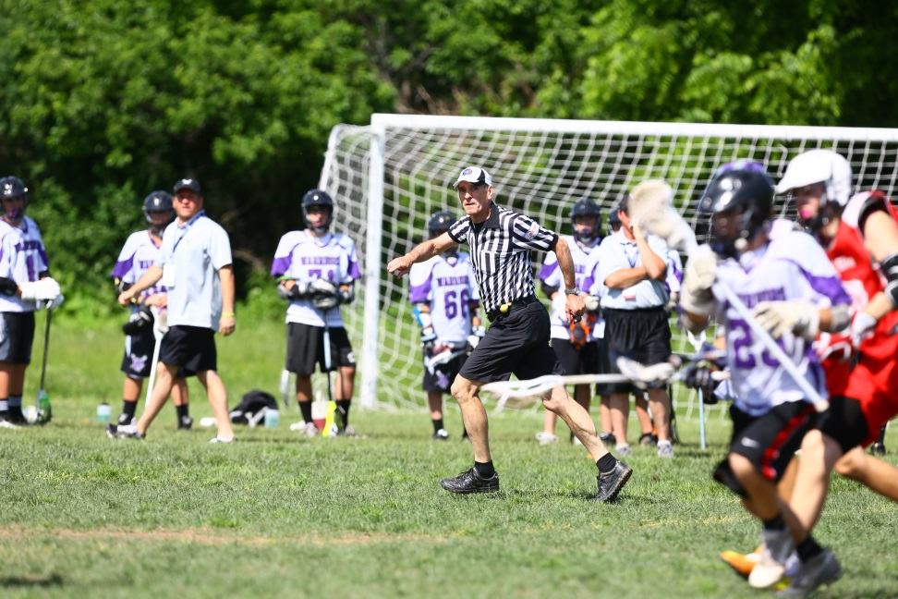
Transition
2-person game until Trail is in position
Single has the transition count
Notes:
2-person game until Trail is in position – Lead and Single work a two-person game until the Trail gets into position near the top of the attack box.
Single has the transition count – Single has the 20 second and 10 second counts in NFHS, and the 30 second count in NCAA. Trail has the 4 second crease count.

Slide 33
Slow Break
M
S
G
M
L
T
T
L
New Trail official must watch for
late hits on long passes!
Manual Page 28
Notes:
The New Lead Official:
- Starts backing up while keeping eyes on the play
- Best done when there is a ground ball or as soon as the goalkeeper makes a save and there was no late hit on the shooter
- Gets to one line ahead of the ball and scans the field
- Continues to stay one line ahead of the ball during the slow break until reaching GLE
The Single Official:
- Has the 20 second clearing count
- Moves outside the developing play and follows it up the field
- Pause at the cone until players cross and make sure there is no offside
The New Trail Official
- Has the 4 second crease count
- Stays even with the ball as it moves upfield. Keeping eyes on off ball action.

Slide 34
Fast Break
S
M
G
M
L
T
T
L
No excuse for the goal to be
uncovered in 3-person game.
Manual Page 28
Notes:
The New Lead Official:
- Goal coverage is the most important thing on a fast break. You must be in position and on or near GLE in order to make the call
- Sprint to cover the field, do not focus on offside. Instead allow your partners to pick up the offside call as they have plenty of time to see the field while you must get to GLE
The Single Official:
- Sprint past the cone and keep your focus on the players in transition. On a fast break it is a two-person game until the Trail is in position, and the focus must be on any late hits after passes or shots on the opposite half of the field.
- Has the transition count
The New Trail Official:
- Has the 4 second crease count
- Make sure all additional action has ceased and then run up to near the midline
- Check for offside
- Jog to your position at the top of the attack box and let your partners know you are in
NOTE: Do not leave your partner hanging. Hustle into your next position and tell your partners that “You’re in!” so they can focus on their main responsibilities as the Lead and Single.

Slide 35
Penalty Enforcement
relaying, reporting, and setting the field

Slide 36
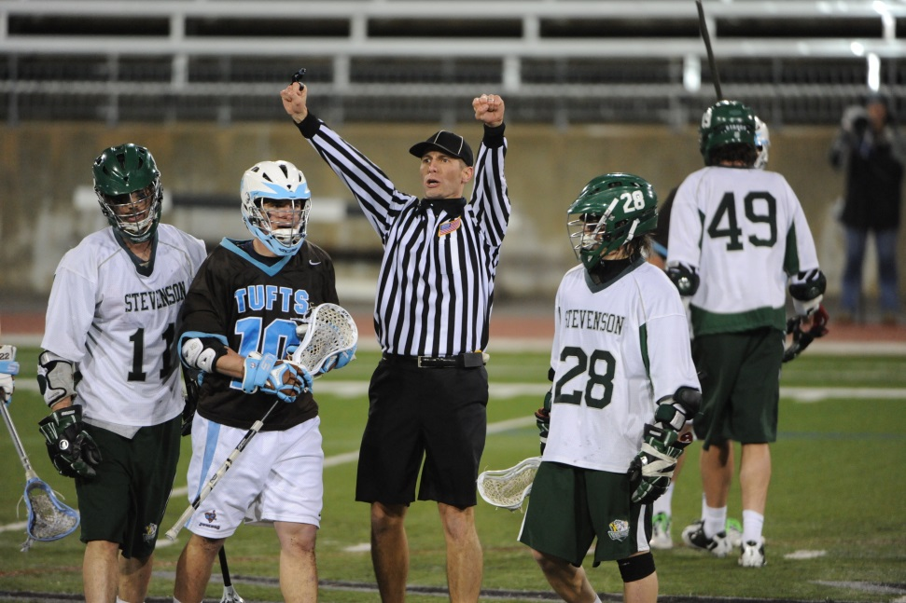
Penalty Enforcement
Echo the “flag down!” call
Tell your partners the call first
Always count both teams before the restart
Notes:
Echo the “Flag down!” call – When one of your partners yells flag down you should do the same. This informs the players on your half of the field, and is especially important during transition so both teams understand that there is a flag down.
Tell your partners the call first – All officials should know the call before anyone else so they can communicate the situation to the teams and table.
Always count both teams before the restart – All officials should count both teams. The official restarting play should only restart after getting the “ready” signal from Single, or seeing both “ready” signals from the Lead and Trail if the Single is restarting play.

Slide 37

Penalty Enforcement
Official who sees foul throws flag and yells “flag down!”
Partners echo the call
Once play is stopped:
  Communicate foul to partners
  Trail reports penalty while Single and Lead set field
  Official restarting play informs goalkeeper of the situation
Flag down!
Blue 36
Unnecessary
Roughness
S
Flag down!
Flag down!
C-NOTE
L
T
1 man down.
Ball side-left.
No rush to restart play after a penalty.
Make sure the field has the right number of players.
Manual Page 29
Notes:
Official witnessing penalty throws flag and yells “flag down!” Partners echo the call.
Stop play when the rules require you to do so.
After stopping play:
- Confirm foul with partners (if multiple flags, sort out if there are multiple penalties or two flags for one penalty)
- Trail will ALWAYS reports the foul using C-NOTE
- Do not come in further than the wing line to report
- Official restarting play informs the goalkeeper of the situation
- All officials should count the teams and make sure the correct number of players are on the field for the restart
NOTE: One official should always have eyes on the players. Do not get so concerned about discussing the foul that the players are not watched during the dead ball time. The official that did not have a flag should stay wide to see the entire field.

Slide 38
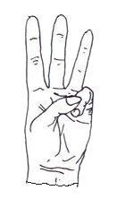
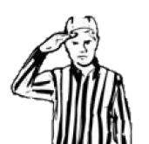
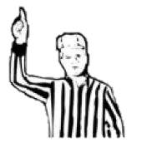
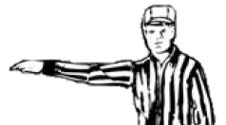
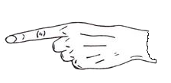
C-NOTE
COLOR
NUMBER
OFFENSE
TIME
“Unnecessary Roughness”
“One Minute”
“Blue”
“36”
Stand still when relaying penalties to the table.
Notes:
C-NOTE is standard to improve communication and consistency:
- Color
- Number
- Offense (foul)
- Time
- Explanation (if necessary)
Color: Point to the half of the field when saying the player’s color. This is a good visual so everyone knows which team the penalty is on even if they cannot hear the color. Especially important in loud games so your table is doubly certain of the color.
Number: Say the number while signaling with one hand above your shoulders.
- 1 through 5 are signaled normally
- 6 through 9 are signaled with the hand turned to one side
- 0 is signaled with a closed fist
Offense (foul): Verbally state the foul and signal the violation clearly and deliberately. Play is stopped and there is no need to rush the signal.
Time: Either a 30-second technical foul (signal “T” with both arms), or a 1, 2, or 3-minute personal foul signaled with one, two, or three fingers
Explanation (if necessary): Not required on every penalty report! On unclear penalties a short statement on why the flag was thrown. No not get into a debate with a coach or player on the penalty. If an explanation is not warranted it is best to say nothing.

Slide 39
Equipment Checks
what to look for

Slide 40
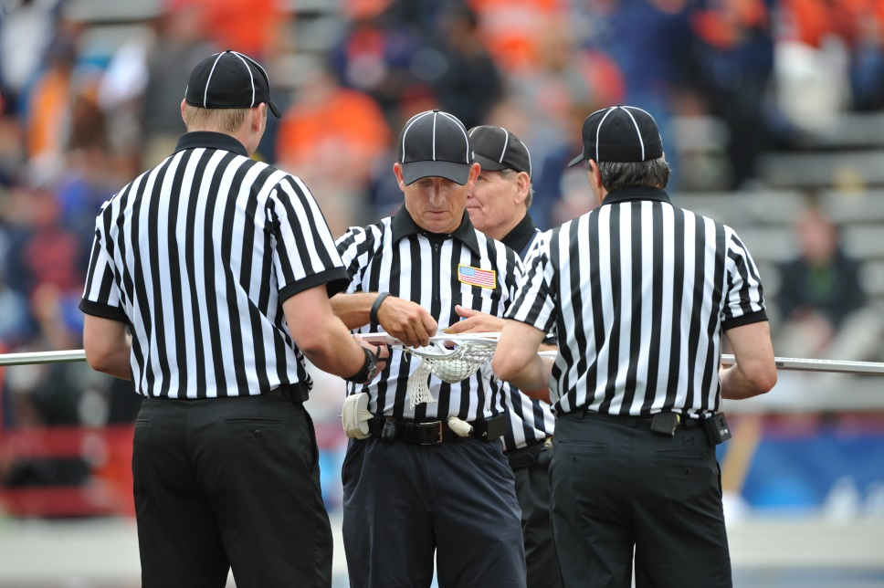
Equipment Checks
Single gets the ball
Trail and Lead grab crosses from closest bench
Stand away from the teams
One official always faces the benches
Notes:
Single gets the ball – Since the Single is furthest away from the bench that official will usually be responsible for getting the ball. Grab one from the sideline if the last ball was flung well out of bounds.
Trail and Lead grab crosses from closest bench – Since all officials rotate across the field during the game it is not practical to say Field Judge gets one team and the Umpire gets the other. Whichever bench you are closest to is the team you’ll grab a crosse for.
Stand away from the teams – Center X is best, but as long as you have distance away from both huddles you’re in good shape. If a coach requests an equipment check, take the crosse from the player and move away from any players in the area. Your partners should provide some interference if players want to get closer to see the inspection.
One official always faces the benches – There must be one set of eyes on the players at all times! This official can hold each crosse while the other official measures it.
NFHS and youth – check the player for all required equipment along with the stick check.
NCAA – only check required equipment if a coach requests a stick check.

Slide 41

Equipment Checks
S
T
L
M
D
Manual Page 33
Notes:
Each official:
- Go to a player and ask for their crosse. Do not dig into a huddle to get one particular player!
- One official should make sure to have a ball. If the ball was shot out of bounds on the last play then get one from the table
- Check the required equipment of each player
- Meet at or near Center X and check both crosses
NOTE: Two officials should face the benches during the equipment check.
NOTE: In NFHS games the officials should inspect all of the player’s required equipment after getting the crosse from the player on all random and coach-requested checks.

Slide 42
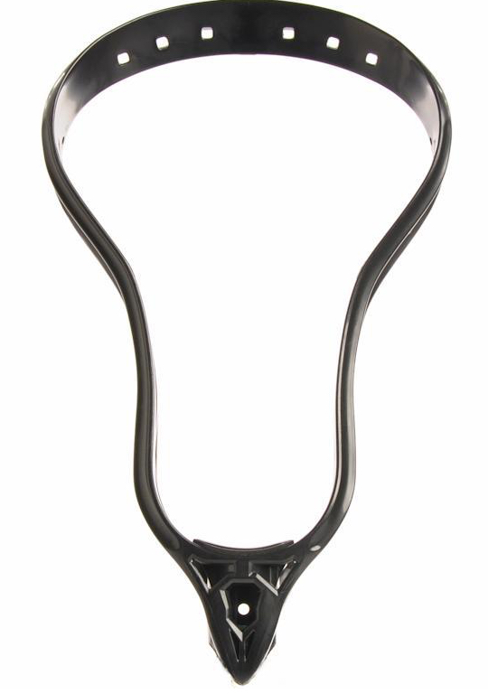

Checking the Crosse
Measure Entire Length
Notes:
There are six aspects of the crosse that you much check:
1. Deep pocket
- Place, DO NOT jam, ball into pocket. If you cannot see over the top of the ball under the plastic the pocket is legal
2. Vertical roll out test
- Place the ball in the crosse, rotate forward. If ball comes out the crosse passes
3. Horizontal roll out test
- Place the ball in the crosse, rotate down towards ground. If call comes out the crosse passes
4. Full crosse length
- Short crosses must be between 40-42 inches long from top of plastic to end of crosse (includes butt end)
- Long crosses must be between 52-72 inches long from top of plastic to end of crosse (includes butt end)
5. Minimum head width
- Measure from the widest point of the plastic from one side to the other
6. Minimum head length
- Measure from the top of the plastic to the start of the plastic at the throat of the crosse (DOES NOT include a ball stop)
NOTE: The deep pocket is the only crosse violation that results in a 1-minute non-releasable penalty. All other violations (except long strings and butt ends) result in a 3-minute non-releasable penalty and the crosse remains at the table for the rest of the game.
NOTE: Stick violations are big penalties. Make sure the crosse is clearly illegal before throwing the flag.

Slide 43
Time Outs
must be vigilant during extended dead ball time

Slide 44
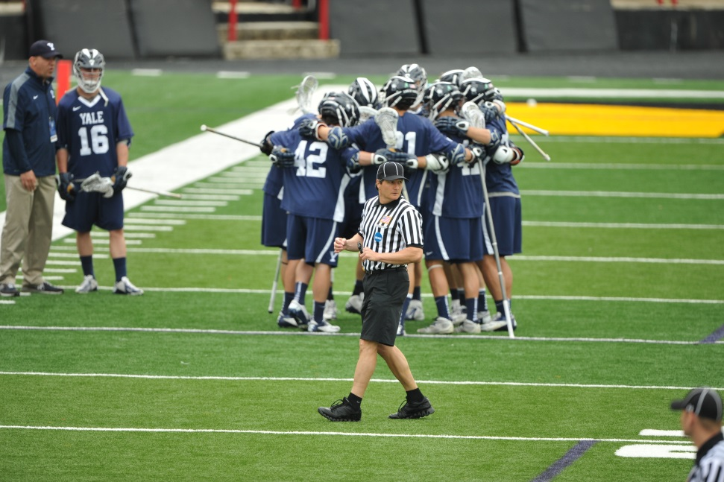
Time Outs
Know when a time out will likely be requested
Sell the time out call if possession is not clear
Notes:
Know when a timeout will likely be requested:
- End of quarter
- Clear with long pole under pressure
- Winning team getting pressure with less than two minutes in game
- First possession in overtime
Sell the time out call if possession is not clear:
Coaches will wait until the last possible moment to call time out if they can help it. A time out is granted as soon as the official recognizes it. If the ball is loose by the time the official blows the whistle, but the player had possession when the coach called for time out, get big and signal timeout while saying “While the player had possession!” That will help clear up any confusion.

Slide 45
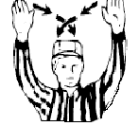
Time Outs
S
D
A
M
M
A
D
G
A
M
M
M
G
D
M
D
D
A
A
D
A
T
Blue!
Time Out!
L
Timeout!
Manual Page 36
Notes:
The official who hears the coach call time out will sound the whistle if the situation allows for one (any dead ball, team in possession of the ball).
Signal timeout and call out the color of the team. The Lead and Trail should hustle to the wing area so there is an official presence during the player crossover. The Single should get to near midfield while keeping an eye on the entire field, especially any players from opposing teams running near one another to their huddles. Paying attention during this dead ball time is critical to head off possible confrontations!
After both teams are in their huddles, meet at center if necessary while keeping your eyes on both benches.
When you meet at midfield each official should write down the time-out, and discuss any mechanics that may be off.

Slide 46
Fight Procedures
what to do when players start swinging

Slide 47
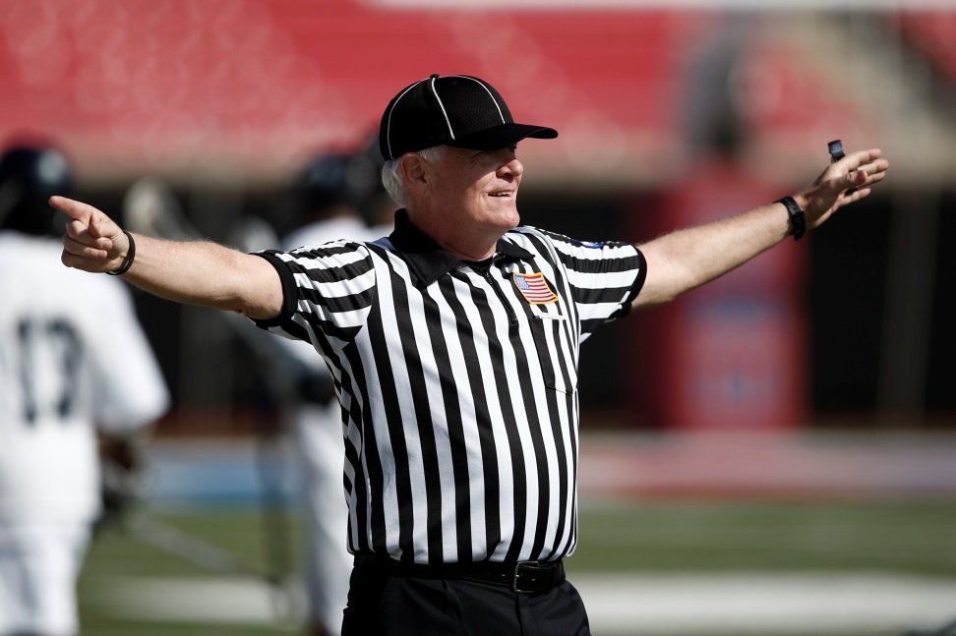
Fight Procedures
Get big and loud to freeze the benches
Do not rush to restart play after a fight
Try your best to get the numbers of everyone involved
Notes:
Get big and loud to freeze the benches:
No one is supposed to go past the line you create with your body. That includes coaches. This is the time to be very loud and make it clear that no one is going to enter into the fight. You may permit coaches to help you get their players back, and you may instruct coaches to help separate the players in the fight if you judge it is appropriate.
Do not rush to restart play after a fight:
Get your bearings and give both teams some time to cool off. Separate the teams (if necessary ask both coaches to get their teams to opposite end lines of the field. Meet with your partner away from the teams, but keep your eyes on them, and discuss the sequence of penalties and how to proceed.
Try your best to get the numbers of everyone involved:
Fights are hectic. Try to remember the numbers of the fighters, or an identifying characteristic if you can’t get the number (like a knee brace). If you’ve frozen the benches write down the numbers of those in the fight near your partner as well as anyone who ran past you after you told them not to.

Slide 48
Fight Procedures
Fight!
S
X
O
L
T
FREEZE!
Notes:
The closest official to the fight:
Runs toward the players fighting and continuously circles them while blowing the whistle. This helps to keep other players from entering into the fight and a whistle blown loudly at close range will get the attention of the fighting players. Communicate that you want the players to stop fighting in between whistle blasts.
NOTE: Physically separating players should only be done if you judge that you can do so without endangering the safety of the players or yourself.
The next closest official to the fight:
Runs towards the off ball players and provides interference for the official in front of the fight. Loudly inform players not to enter into the fight and mentally note any players that go into the fight if they ignore you. Keep moving and keep blowing your whistle until the fight ends.
The official furthest from the fight:
Get to a space in the open field near the benches and loudly shout “Freeze!” while spreading your arms. Repeat that often and instruct the coaches to assist you in keeping the players on their bench. Any player running past you is considered entering into the fight. Once the benches are frozen turn to your partner and record the numbers of all players involved in the fight.

Slide 49
Questions?
Contact:
  Your LOA’s certified trainer
  USL Official’s Education staff at officials@uslacrosse.org
Thank you for viewing this presentation
Good luck in your next game!
Notes:
Trainer Note: It is highly recommended that you provide the trainees with your email address at the end of the training class with instructions to contact you if they are confused about a particular mechanic or situation. If you have an association rules interpreter this is also a good time to introduce him to the class if they have specific rules questions.

