Slide 1
Personal Foul
Red
13
Illegal Body Check
1-minute

Slide 2
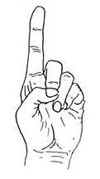
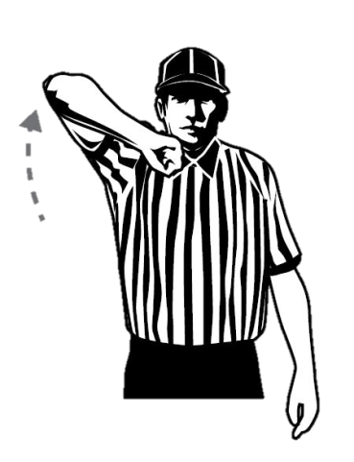
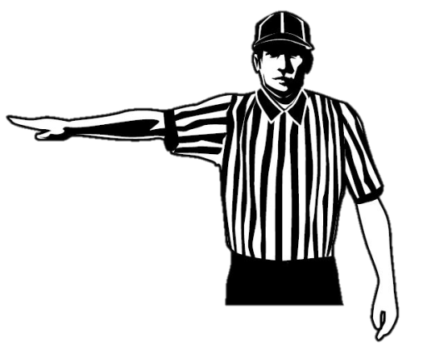
Personal Foul
Red
One, Three
Illegal Body
Check
One Minute

Slide 3
Personal Foul
Blue
50
Illegal Body Check
Contact to the head/neck
2-minutes
Non-releasable

Slide 4
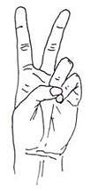
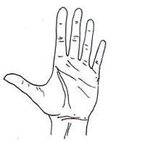
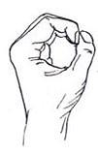
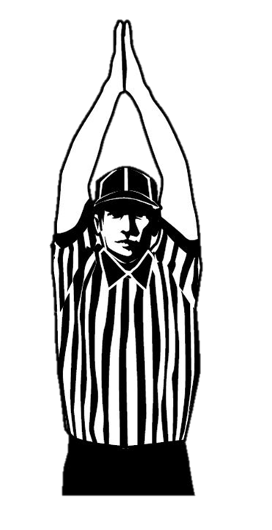
Personal Foul
Contact to the head
Blue
Five, Zero
Illegal Body Check
Two Minutes
Non-releasable

Slide 5
Personal Foul
Red
62
Unnecessary Roughness
Contact to the head/neck
3-minutes
Non-releasable

Slide 6
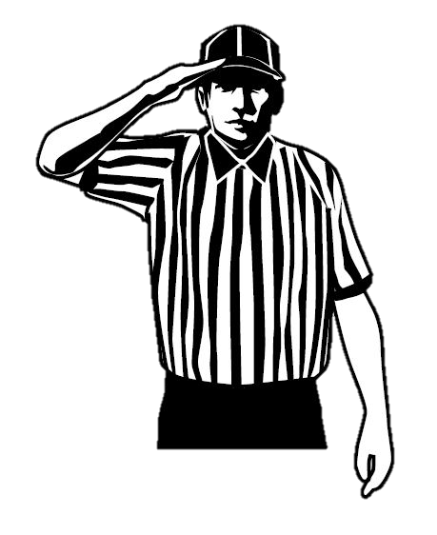
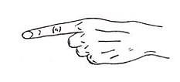
Personal Foul
Contact to the head
Red
Six, Two
Unnecessary Roughness
Three Minutes
Non-releasable

Slide 7
Personal Foul
Blue
27
Cross-Check
1-minute

Slide 8
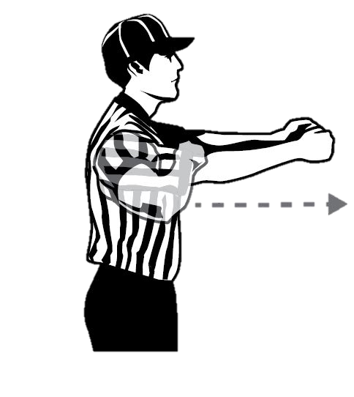
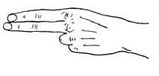
Personal Foul
Blue
Two, Seven
Cross-Check
One Minute

Slide 9
Personal Foul
Red
8
Illegal Crosse
3-minutes
Non-releasable

Slide 10
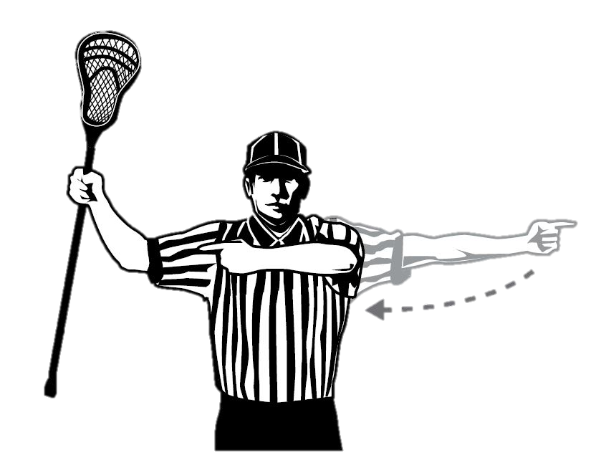
Personal Foul
Red
Eight
Illegal Crosse
Three Minutes
Non-releasable

Slide 11
Personal Foul
Blue
35
Deep Pocket
1-minute
Non-releasable

Slide 12
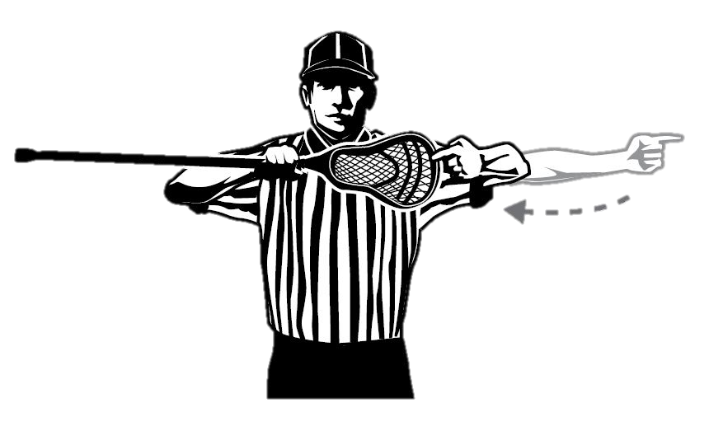
Personal Foul
Blue
Three, Five
Deep Pocket
One Minute
Non-releasable

Slide 13
Personal Foul
Red
6
Illegal gloves (equipment)
1-minute
Non-releasable

Slide 14
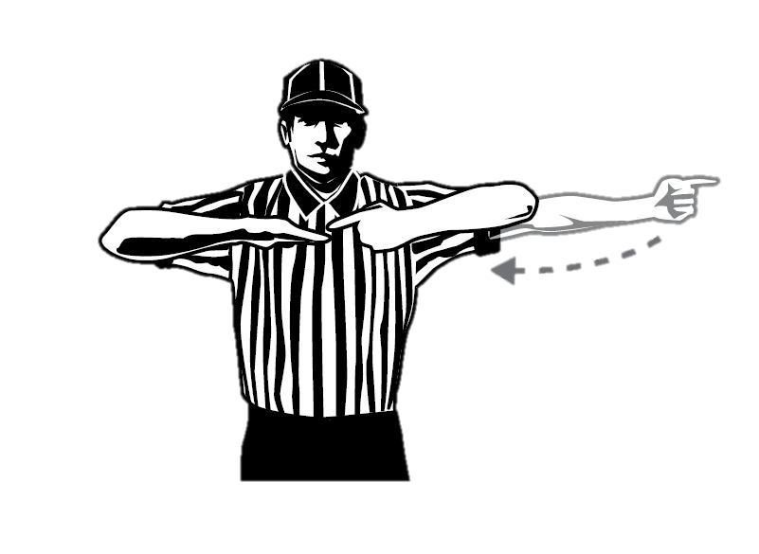
Personal Foul
Red
Six
Illegal Gloves
One Minute
Non-releasable

Slide 15
Personal Foul
Blue
53
Slashing
1-minute

Slide 16
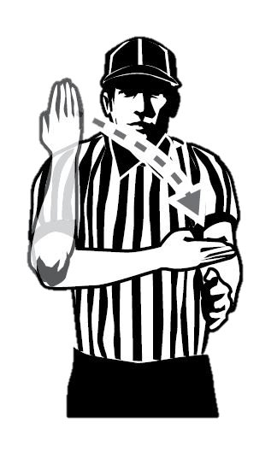
Personal Foul
Blue
Five, Three
Slashing
One Minute

Slide 17
Personal Foul
Red
19
Tripping
1-minute

Slide 18
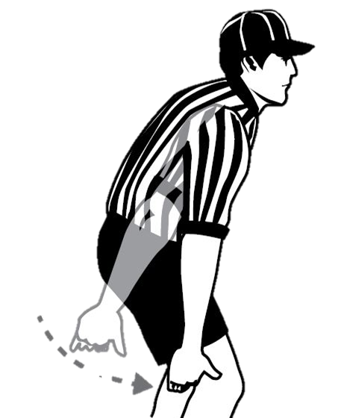
Personal Foul
Red
One, Nine
Tripping
One Minute

Slide 19
Personal Foul
Blue
31
Unnecessary Roughness
2-minutes

Slide 20
Personal Foul
Blue
Three, One
Unnecessary Roughness
Two Minutes

Slide 21
Personal Foul
Red
48
Unsportsmanlike Conduct
1-minute

Slide 22
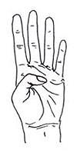
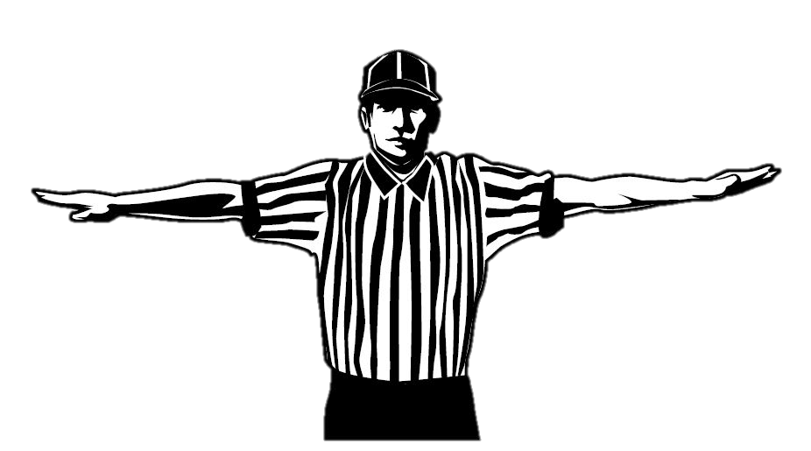
Personal Foul
Red
Four, Eight
Unsportsmanlike Conduct
One Minute
Non-releasable

Slide 23
Personal Foul
Blue
20
Unsportsmanlike Conduct (fighting)
3-minutes
Non-releasable
Ejection

Slide 24
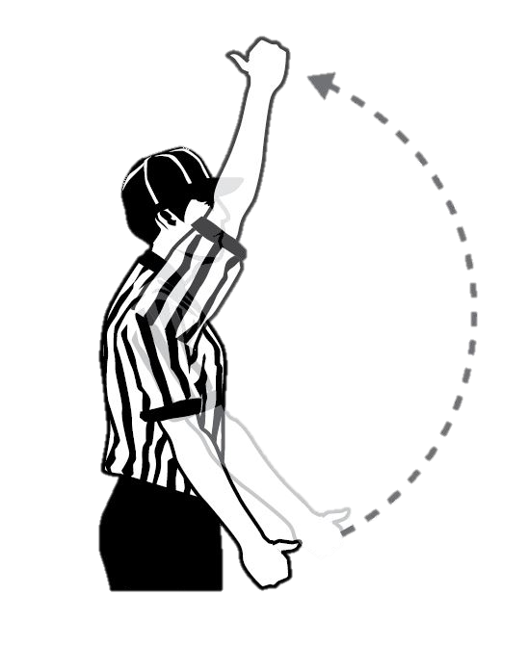
Personal Foul
Blue
Two, Zero
Unsportsmanlike Conduct
Three Minutes
Non-releasable
Non-releasable

