Slide 1
Technical Foul
Red
10
Holding
30-seconds

Slide 2
Technical Foul
Red
One, Zero
Holding
Thirty Seconds

Slide 3
Technical Foul
Blue
27
Illegal Procedure
30-seconds

Slide 4
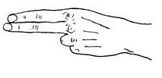
Technical Foul
Blue
Two, Seven
Illegal Procedure
Thirty Seconds

Slide 5
Technical Foul
Red
38
Delay of Game
30-seconds

Slide 6
Technical Foul
Red
Three, Eight
Delay of Game
Thirty Seconds

Slide 7
Technical Foul
Blue
11
Substitution Infraction
30-seconds

Slide 8
Technical Foul
Blue
One, One
Substitution Infraction
Thirty Seconds

Slide 9
Technical Foul
Red
28
Conduct
30-seconds

Slide 10
Technical Foul
Red
Two, Eight
Conduct
Thirty Seconds

Slide 11
Technical Foul
Blue
71
Interference
30-seconds

Slide 12
Technical Foul
Blue
Seven, One
Interference
Thirty Seconds

Slide 13
Technical Foul
Red
40
Offside
30-seconds

Slide 14
Technical Foul
Red
Four, Zero
Offside
Thirty Seconds

Slide 15
Technical Foul
Blue
18
Pushing
30-seconds

Slide 16
Technical Foul
Blue
One, Eight
Pushing
Thirty Seconds

Slide 17
Technical Foul
Red
5
Withholding Ball from Play
30-seconds

Slide 18
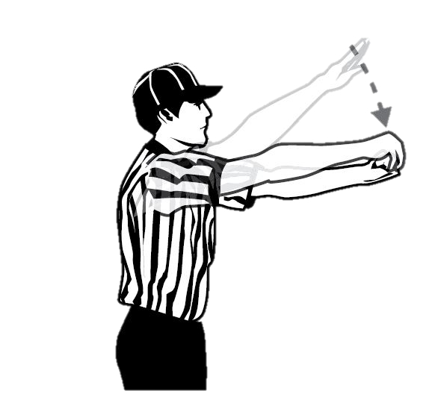
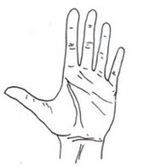
Technical Foul
Red
Five
Withholding Ball from Play
Thirty Seconds

