Slide 1
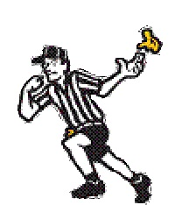
WMLOA
2019 Preseason Clinic
NCAA Rules Overview

Slide 2
2019 NCAA Rule and Mechanic Presentation
To Be Used for Prep Schools:
High School vs College Modifications
Review the 2019/2020 Points of Emphasis
Review the 2019/2020 Major Rule changes
NCAA vs NFHS Differences (not yet released)

Slide 3
2019 Rule and Mechanic Presentation
High School vs College Modifications:
SHOT CLOCK
For the 2019 season the prep schools will NOT be utilizing a continuous 80 second shot clock
Stalling Mechanic will be the same as last year (NOT IN 2019 RULE BOOK)
Advancing the Ball
30 seconds to clear the ball & touch it into the box
Over and Back
Once the ball has been touched into the box, a team may not go back over the midfield line
Exceptions apply

Slide 4
2019 Rule and Mechanic Presentation
Advancing the ball
A team that is clearing the ball is allotted 30 seconds from possession to clear the ball and touch it into the offensive box
Over and Back – Once the team has satisfied the clearing rule, they are not permitted to go back over the midfield line.
3 Man Mechanic: Upon possession, give reset signal. Single will start 20 second timer. When timer goes off, single will start visible 10 second count.
2 Man Mechanic: Same as above but done by trial.
A clearing team that enters the alley and calls a live ball timeout prior to entering the attack area has satisfied the 30 second clearing count.
Over and back rule would be enforced when play is restarted.

Slide 5
2019 Rule and Mechanic Presentation
Over and Back (exceptions)
A loose ball that leaves the offensive half of the field and was last touched by the defensive team.
A loose ball that leaves the offensive half of the field and the defense is called for a loose ball violation (or play-on) or caused the ball to go out of bounds in defensive end.
The defensive team causes the ball to go out of bounds in the defensive end.

Slide 6
2019 Rule and Mechanic Presentation
Over and Back (exceptions)
NOTE – A shot that hits the pipe, or goalie and returns to the defensive end of the field will be treated the same as a defensive deflection.
NO VIOLATION has occurred.
In all these situations a new 30 second clearing count will be initiated for the team that gains possession of the ball
After shot that hits the goalie or goal post and is rolling to midfield and the attacking team attempts to pick up the ball and deflects it over midfield. This is over and back since they did possess and were last to touch.

Slide 7
2019 Rule and Mechanic Presentation
Shot Clock (Old Rule 6-11)
All schools must have a visible shot
Operated by person outside of officiating crew
Crucial to have a pregame conversation with clock operator.
Duties - Refer shot clock operator to Old Rule 2-12, p. 23
Start/reset clock on game official’s verbal and visual signal.
Stop, start and restart shot clock in sync with game clock.
Blow horn if shot clock expires without a reset.

Slide 8
2019 Rule and Mechanic Presentation
Stall Warning (Shot Clock)
In cases where the shot clock does not start within five (5) of the officials signaling the clock to begin or reset, game officials are instructed to stop play and reset the clock to 25 seconds. Note: in the event of an imminent scoring opportunity, officials shall allow the scoring opportunity to continue and stop play to reset the shot clock when complete.
Officials shall continually verbalize and signal during the 5 second delay in an attempt to get clock reset.
Approved ruling – In ALL cases when play has to be stopped due to delay in starting, the shot clock is reset to 25 seconds

Slide 9
2019 Rule and Mechanic Presentation
Stall Warning (Shot Clock) Old Rule 6-11
Triggers – not all inclusive just some tips
Items to consider that may trigger a shot clock situation
New – shots that are considered possession shots
Change in offense that no longer attacks the goal
Offensive player standing in the attack area with the defense playing the ball
Offense not setting picks to create a scoring opportunity
Offense not trying break down their man 1 on 1
Offensive player beating his man and turns back instead of going to goal
Offensive player in an obvious shooting position that chooses not to shoot or continually shoots high or wide

Slide 10
2019 Rule and Mechanic Presentation
Stall Warning (Shot Clock) Old Rule 6-11
Triggers – tips (continued)
Items to consider that would not trigger a shot clock situation.
Defense is better than the offense
Defense in a packed in zone
Defense switches from man to zone or zone to man
Offense feeds the crease (attempt to create offense)
Defense hung up on crease (however they don’t get forever here)
Deliberate offense that is run in a reasonable amount of time.

Slide 11
2019 Rule and Mechanic Presentation
Stall Warning (Shot Clock)
What ends a shot clock once it has been put on:
Goal
Change of Possession / turnover
A stoppage to administer a time serving foul
If the period ends during a shot clock situation, the shot clock is no longer in effect.
Valid Shot
Shot, taken from above GLE, that hits the goalie or goal post

Slide 12
2019 Rule and Mechanic Presentation
Shot Clock Mechanics – No visible Shot Clock
Verbalize to “ALL” every 10 seconds
The shot clock operator is to be located near the intersection of the midline and substitution area.
They will provide a hand signal at the ten second remaining on shot clock by raising arm straight up.
At the five second remaining on shot clock the arm will then be moved to shoulder height along the sideline.

Slide 13
2019 Rule and Mechanic Presentation
Points of Emphasis
Team Conduct/Decorum Pregame and Postgame
Player behavior during pregame warm-ups is a concern
Committee established a 5 yard buffer on either side of midline as neutral area during pregame
Coaches are asked to monitor and discuss sportsmanship issues with their teams
Postgame, coaches shall be cognizant of teams crossing at the end of the game, which creates issues.

Slide 14
2019 Rule and Mechanic Presentation
Points of Emphasis
Faceoffs
The overriding principle is for both players to play the ball
Clamping is allowed on the initial move only; anything more is withholding the ball from play
The use of the helmet during the faceoff is serious concern. The game officials will be asked to determine any potential violation when the helmet to helmet contact occurs.

Slide 15
2019 Rule and Mechanic Presentation
2019/2020 Major Rule Changes
Rule 1-10 Substitution Area
Rule 4-21 Goal crease prohibitions
Rule 6-5-a Picks

Slide 16
2019 Rule and Mechanic Presentation
Rule 1-10 Substitution Area
All fields are lined with the substitution area of a full 20 yards long 10 yards from the center line The 20 yard substitution area will be divided into sections as follows.
Cones will be placed on each sideline 5 yards from the centerline. The area between the cones will serve as the substitution box. Only players serving penalty time, players ready to substitute on the fly and official scorers and timers are allowed in this section of the substitution area. All substituting players must enter the field in the 10 yard area between the cones.

Slide 17
2019 Rule and Mechanic Presentation
Rule 1-10 Substitution Area
The remaining 5 yards from the cone to the end of the large 20 yard substitution area (5 yards) will be reserved for imminent substituting players and coaches instructing players.
All other players and coaches shall remain in the team bench areas.

Slide 18
2019 Rule and Mechanic Presentation
Rule 4-21 Goal crease prohibitions (THE DIVE)
If an offensive player, in possession of the ball and outside the crease area, dives or jumps in a direction away from the goal mouth and lands in the crease, the goal shall be allowed, provided the ball enters the goal before contact with the crease, goaltender, or the goal.
If an offensive player, in possession of the ball and outside the crease area, dives or jumps in a direction that is not away from the goal mouth and lands in the crease, the goal shall be disallowed. In addition, the player shall be penalized with a minimum of a 1 minute foul. The penalty may be releasable or non-releasable at the discretion of the referee. Contact is not required for a foul to be called under this rule. Defensive contact legal or illegal may have an effect on this play.

Slide 19
2019 Rule and Mechanic Presentation
Rule 4-21 Goal crease prohibitions
Note: The “Goal Mouth” is the area directly in front of the goal cage, including the goal line, where the goalkeeper is located and plays his position. A player “diving” must dive in a direction away from the goal mouth.
The following Interpretation is to be used when a player intentionally leaves his feet (becomes airborne of his own volition) in a direction NOT AWAY from the goal mouth and lands in the crease. Although the committee has allowed the dive a player that dives in a direction NOT AWAY from the goal mouth NEEDS to be assessed the appropriate penalties. Protection of the goaltender is still a key priority.

Slide 20
2019 Rule and Mechanic Presentation
Goal mouth
where the goalkeeper
is located and
plays
his position
Goal mouth

Slide 21
2019 Rule and Mechanic Presentation
Rule 4-21 Goal crease prohibitions
Rule of thumb
The committee wants the attacking player to have an opportunity to dive to open space within the crease. If this happens typically it will result in a direction away from the goal mouth.
If a player dives away from goal mouth and during the process the goalie initiates contact this will usually result in a crease violation.

Slide 22
2019 Rule and Mechanic Presentation
Open Space
The white within
crease
Goal mouth

Slide 23
2019 Rule and Mechanic Presentation
Rule 4-21 Goal crease prohibitions
There can be two types of penalties releasable and non-releasable.
One minute releasable for unsportsmanlike will be called for a player that dives in a direction that is not away from the goal mouth and has no contact with the goaltender.
A 1 to 3 minute non-releasable unsportsmanlike conduct foul is to be called when contact with the goaltender is made. The penalty time is based on severity of the contact but in no circumstance less than a 1 minute non-releasable foul.

Slide 24
2019 Rule and Mechanic Presentation
Rule 4-21 Goal crease prohibitions
A.R. 79a.
A1 dives or jumps away from the goal mouth and, while in the air, is legally checked into the crease. (1) The ball goes into the goal prior to contact with the crease, goaltender or goal; or (2) The ball does not go into the goal.
RULING: (1) Goal is allowed; (2) Crease violation on A1.

Slide 25
2019 Rule and Mechanic Presentation
Rule 4-21 Goal crease prohibitions
A.R. 79b.
A1 dives or jumps away from the goal mouth and, while in the air, is illegally checked into the crease. (1) The ball goes into the goal prior to contact with the crease, goaltender or goal; or (2) The ball does not go into the goal.
RULING: (1) Flag-down, goal counts, assess penalty; (2) Flag-down, assess penalty
Note – do not allow the defensive player to take liberties here.

Slide 26
2019 Rule and Mechanic Presentation
Rule 4-21 Goal crease prohibitions
A.R. 80a.
A1 dives or jumps in a direction that is not away from the goal mouth and, while in the air, is legally checked into the crease (1) The ball goes into the goal prior to contact with the crease, goaltender or goal; or (2) The ball does not go into the goal.
RULING: (1 and 2) No goal. Flag-down, assess penalty on A1.

Slide 27
2019 Rule and Mechanic Presentation
Rule 4-21 Goal crease prohibitions
A.R. 80b.
A1 dives or jumps in a direction that is not away from the goal mouth and, while in the air, is illegally checked by B1 into the crease (1) The ball goes into the goal prior to contact with the crease, goaltender or goal; or (2) The ball does not go into the goal.
RULING: (1 and 2) No goal. Flag-down, assess penalties on A1 and B1 and award possession according to Rule 7-6-c.
All other A.R.s in this section are unchanged

Slide 28
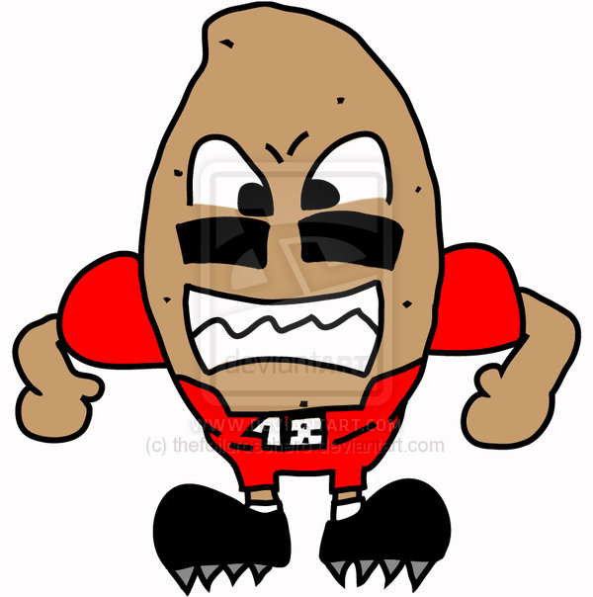
2019 Rule and Mechanic Presentation
Rule 4-21 Goal crease prohibitions
Ruling: No Goal
Penalty will be called

Slide 29
2019 Rule and Mechanic Presentation
Rule 4-21 Goal crease prohibitions
Ruling: Goal counts
If no contact prior to
Ball entering

Slide 30
2019 Rule and Mechanic Presentation
Rule 4-21 Goal crease prohibitions
Ruling: Goal counts
If no contact prior to
Ball entering

Slide 31
2019 Rule and Mechanic Presentation
Rule 4-21 Goal crease prohibitions
Ruling: No Goal
Too tight to goal
Penalty will be called

Slide 32
2019 Rule and Mechanic Presentation
Rule 4-21 Goal crease prohibitions
Ruling: No Goal
Player is not greater
Than parallel with
Goal mouth

Slide 33
2019 Rule and Mechanic Presentation
Rule 4-21 Goal crease prohibitions
Ruling: Goal counts
If no contact prior to
Ball entering

Slide 34
2019 Rule and Mechanic Presentation
Rule 4-21 Goal crease prohibitions
Ruling: Goal counts
If no contact prior to
Ball entering – there
Is space between pipe

Slide 35
2019 Rule and Mechanic Presentation
Rule 4-21 Goal crease prohibitions
Ruling: No Goal
Too tight to goal
Penalty will be called

Slide 36
2019 Rule and Mechanic Presentation
Rule 6-5-a Picks
In establishing and maintaining legal screening tactics, the screener shall:
Stay within his vertical plane with a stance in which the inside of the screeners feet (heel) is no wider than shoulder width apart and ……….
All other aspects of screening remains the same as previous years.

Slide 37
2019 Rule and Mechanic Presentation
Mechanics – faceoff
The faceoff is still a critical part of the game.
We as officials need to follow the approved mechanic when conducting all faceoffs ensure they are conducted as quickly as possible, as fairly as possible and efficiently as possible.
Not following the mechanic brings inconsistency to the process and confusion for the players involved.

Slide 38
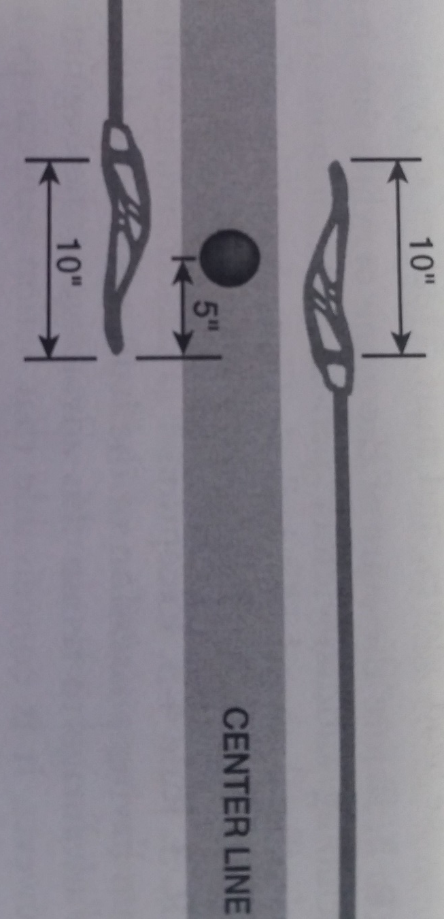
2019 Rule and Mechanic Presentation
Faceoff – (Point of Emphasis)
Rule 4 -3 b – 4
Needs to be administered as written in rulebook

Slide 39
2019 Rule and Mechanic Presentation
NCAA vs NFHS – Other Major Differences
Face off violations (no play on, count the violations)
Goalie Out of Crease (no 5 seconds)
Defender is w/in 5 yards on restart (start immediately – can be flag)
Last 2:00 of 4th quarter
Second NR USC foul (same person)
Checks to the head and neck (can be 1 min penalty)
Tape on head (no one but goalie)
End of Flag Down
Timeouts

Slide 40
2019 Rule and Mechanic Presentation
Questions

