Slide 1
Officiating Philosophy

Slide 2

Notes:
Want to make money?
Help grow the sport?
Be part of a great officiating community?
Have know idea.
Give some personal reasons.
Are you in the game only to collect a pay check?
If you are, maybe rethink why you want to be a lacrosse official.
Hopefully you want to be part of a great sport and help it grow.
Or be part of great group of guys in a great community.
If you have know idea, hopefully we will help you figure it out.
Does anyone want to share why they are here tonight and why they want to be an official?

Slide 3
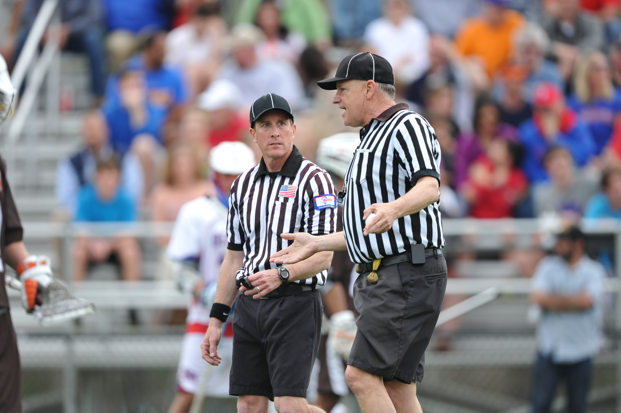
What Makes a Good Official?
Rules
Fitness
Timeliness
Appearance
Student
Pre-Game
Notes:
Often, you have very little time to fully prepare for games.
You have to change into your uniform in the parking lot
Rush though a quick pregame walking to the field from the parking lot with the other officials.
Start mentally preparing while driving to the game
Go through game situations in you head
Think about past situations in games
Relax
Know the rules is on of the best ways to be ready.
Keep your rule book in your gear bag.
If you get to the field early, read a couple rules and AR (game situations)
Be a student of the game
Study the rules book, watch video, participate in message boards, ask questions
Be on time to meet for a proper pregame
Look like a prepared official. How does your uniform look?
If you look the part, you can better play the part.
Get and stay in shape.
You will do a lot running.
Don’t wait for the season to start before preparing.

Slide 4
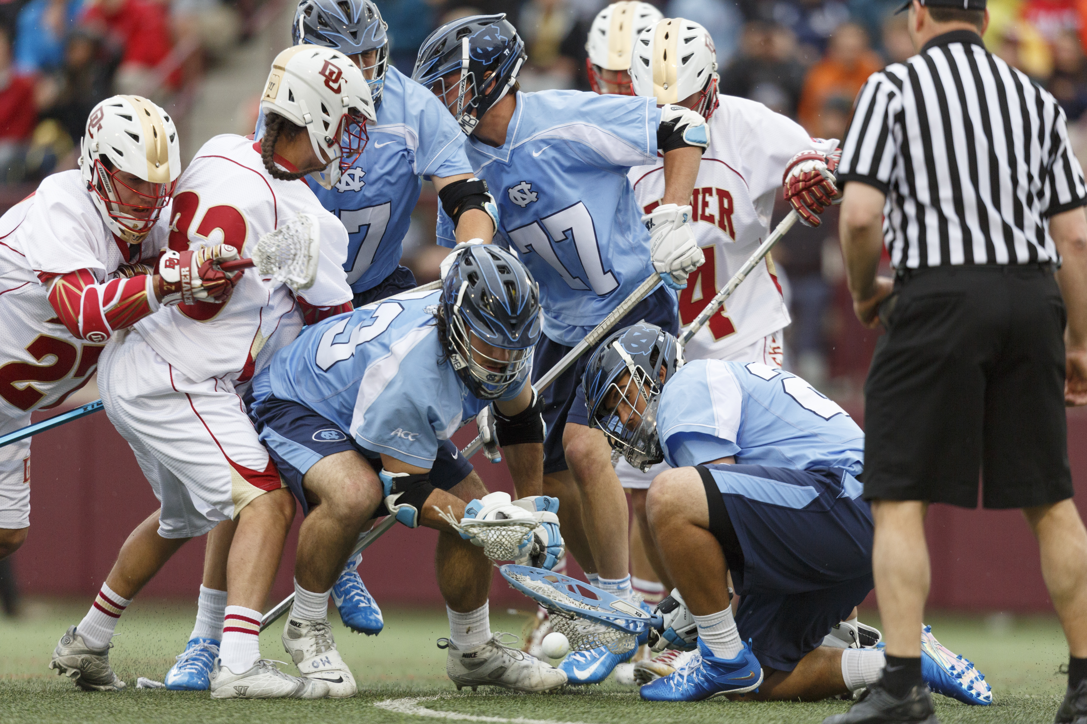
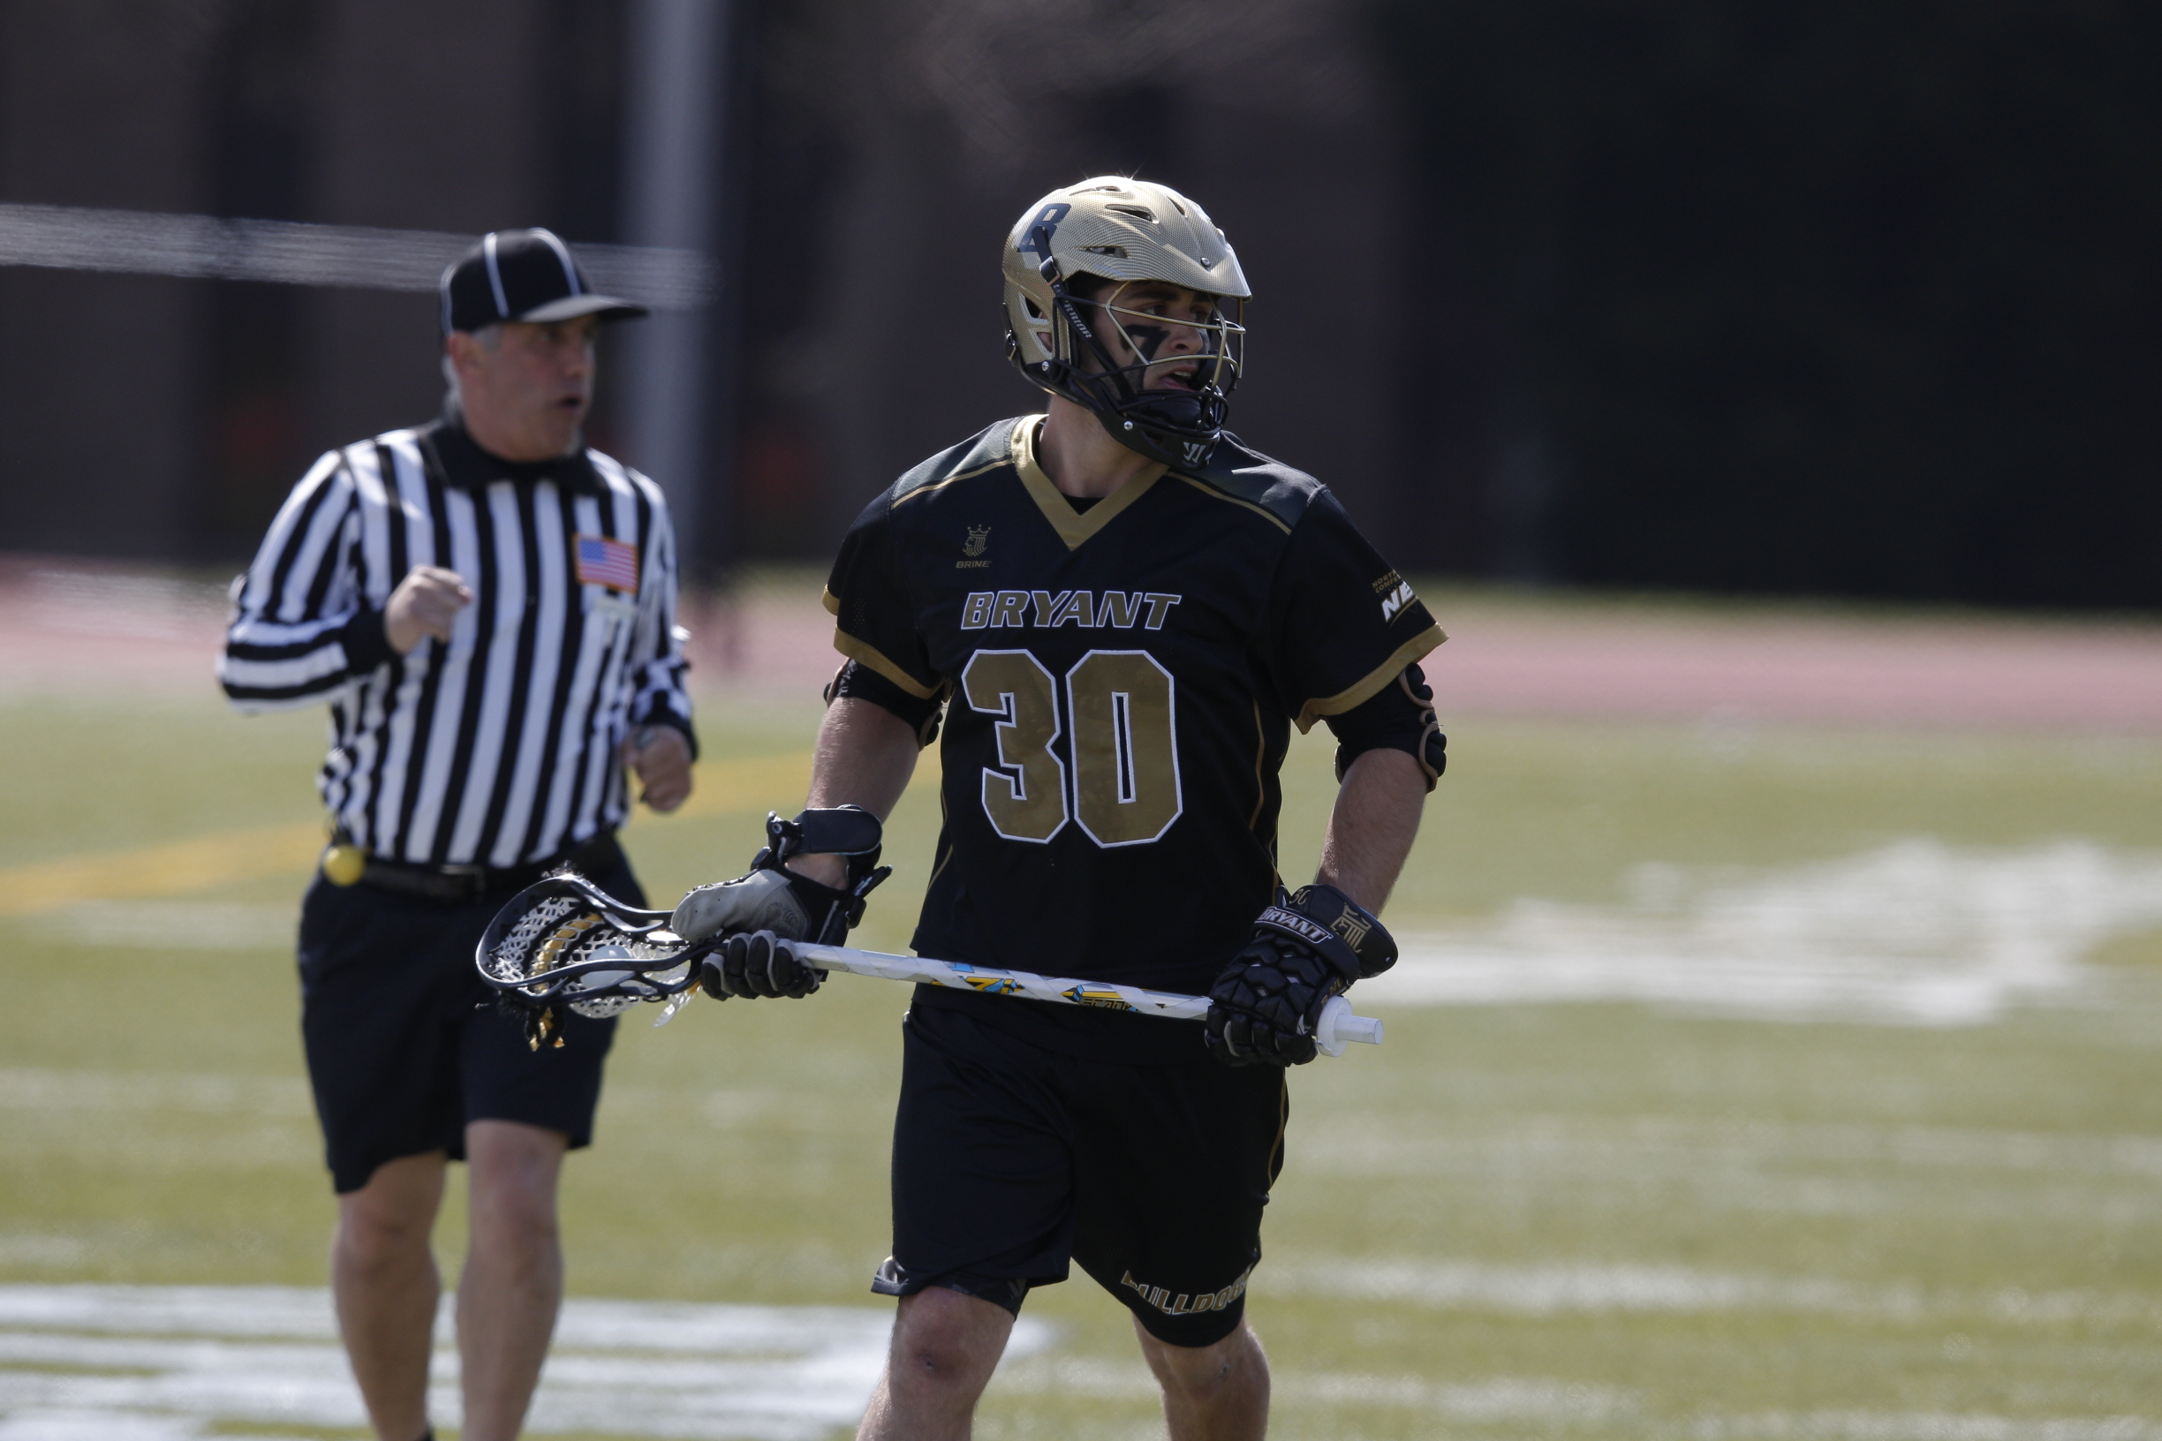
Good Officiating - Positioning
Notes:
If you are physically prepared you will be in position to make the right call.
Hustle, but to get too far ahead of the play so you don’t miss a call.
Know where to be on the field in specific situations

Slide 5
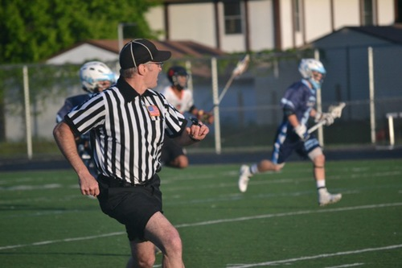
Good Officiating – Flow of the Game
Notes:
Good official are able to read the context of the game early.
Is it chippy early?
Is one team far better than the other?
Are there personalities involved?
Past history of the teams?
You need to be able to adjust to the level of play.
You don’t call a lower level JV game the same way you call two top D1 teams.
You don’t call a youth game the same way you call a HS game.
Don’t get stuck on your mistakes. Move past them quickly.
You have to get the rough, unnecessary and cheap penalties.
Keep it in control and clamp down early if necessary.

Slide 6
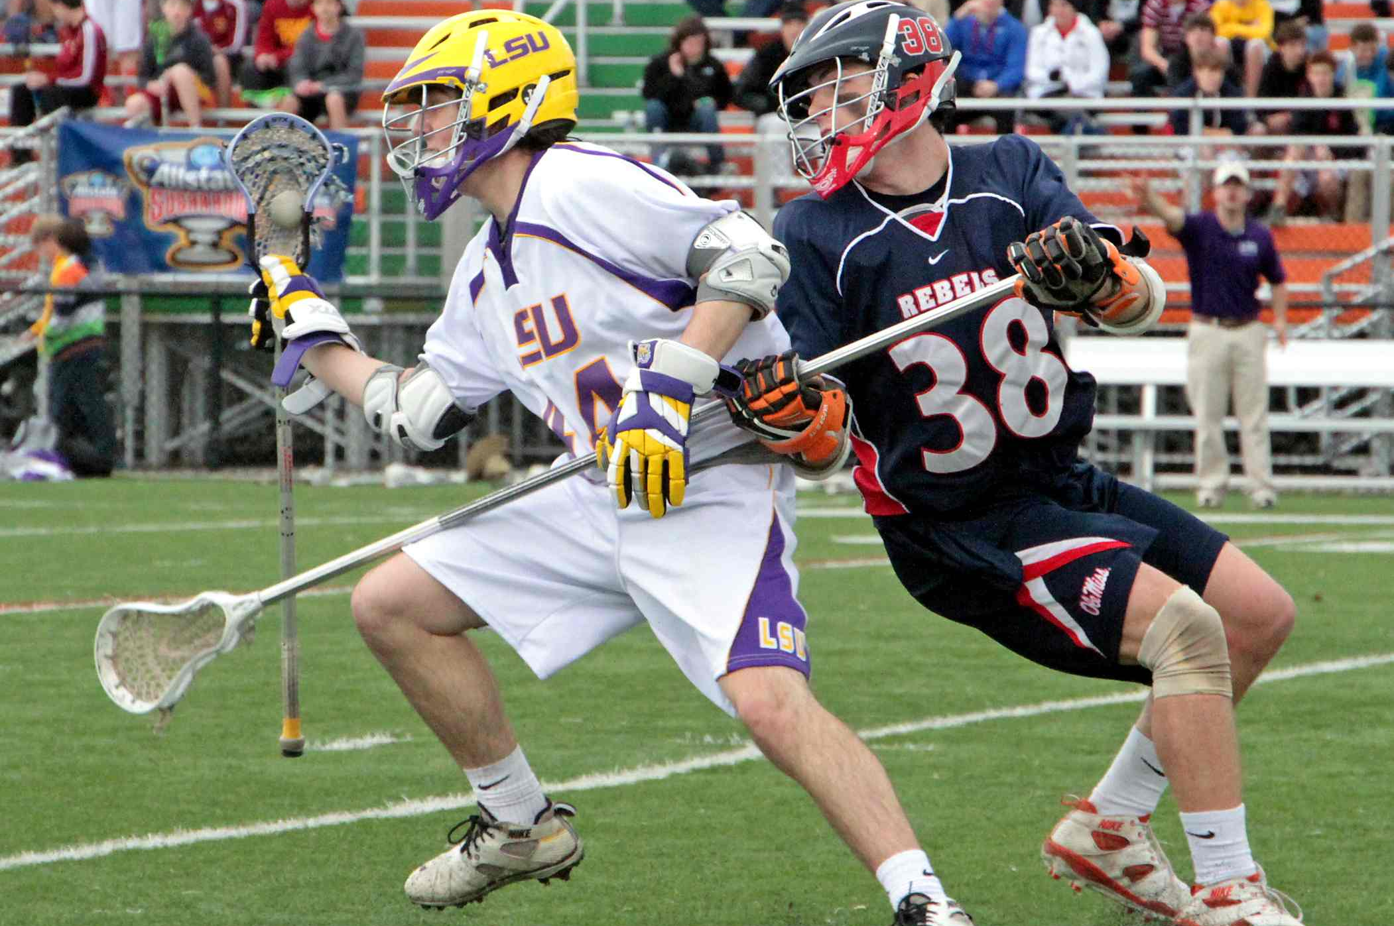
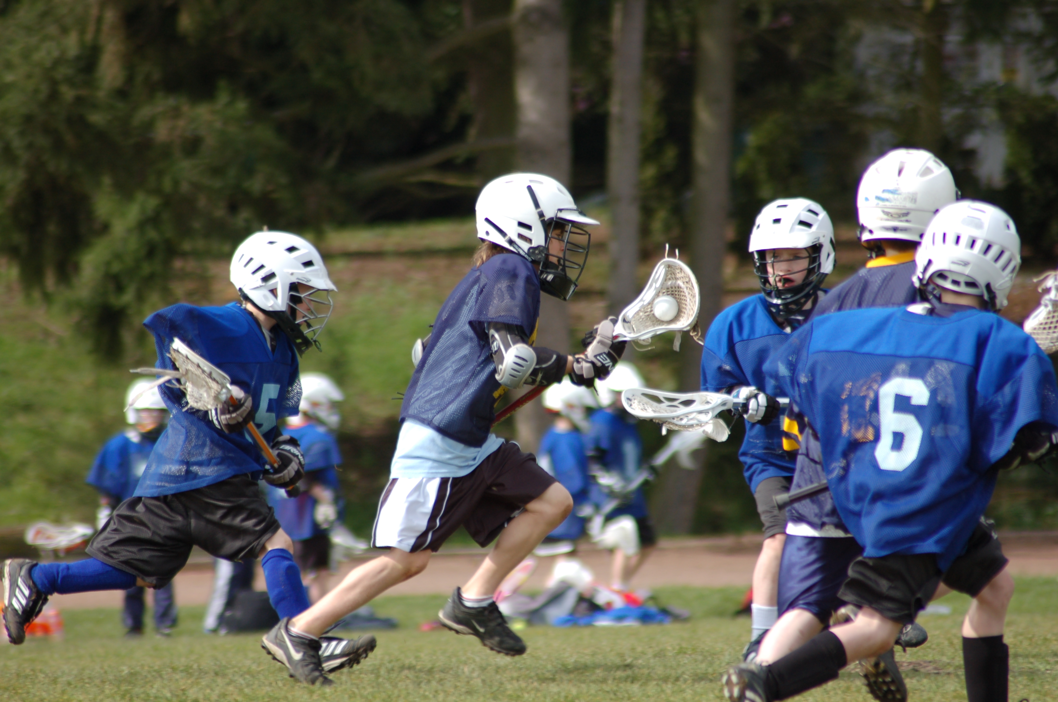
Good Officiating – Adjust to Level of Play
Notes:
You need to be able to adjust to the level of play.
You don’t call a lower level JV game the same way you call two top D1 teams.
You don’t call a youth game the same way you call a HS game.
You have to get the rough, unnecessary and cheap penalties.
Keep it in control and clamp down early if necessary.

Slide 7
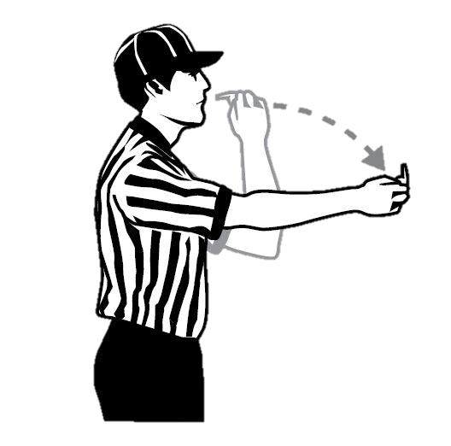
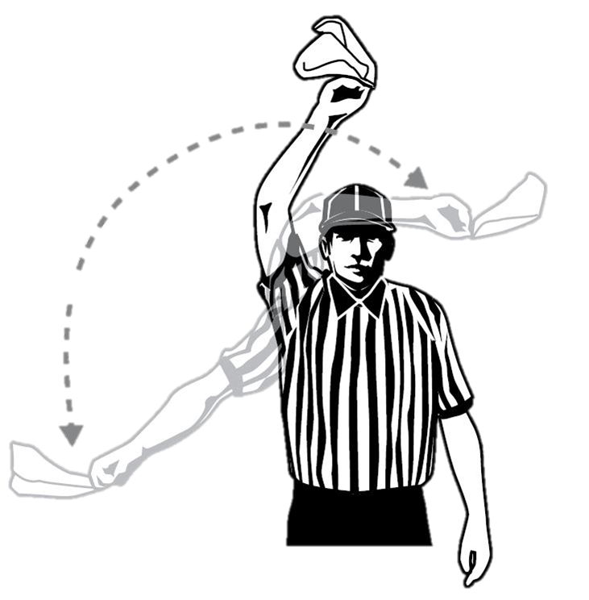
Good Officiating – Adjust to Level of Play
Notes:
Don’t get stuck on your mistakes. Move past them quickly.

Slide 8
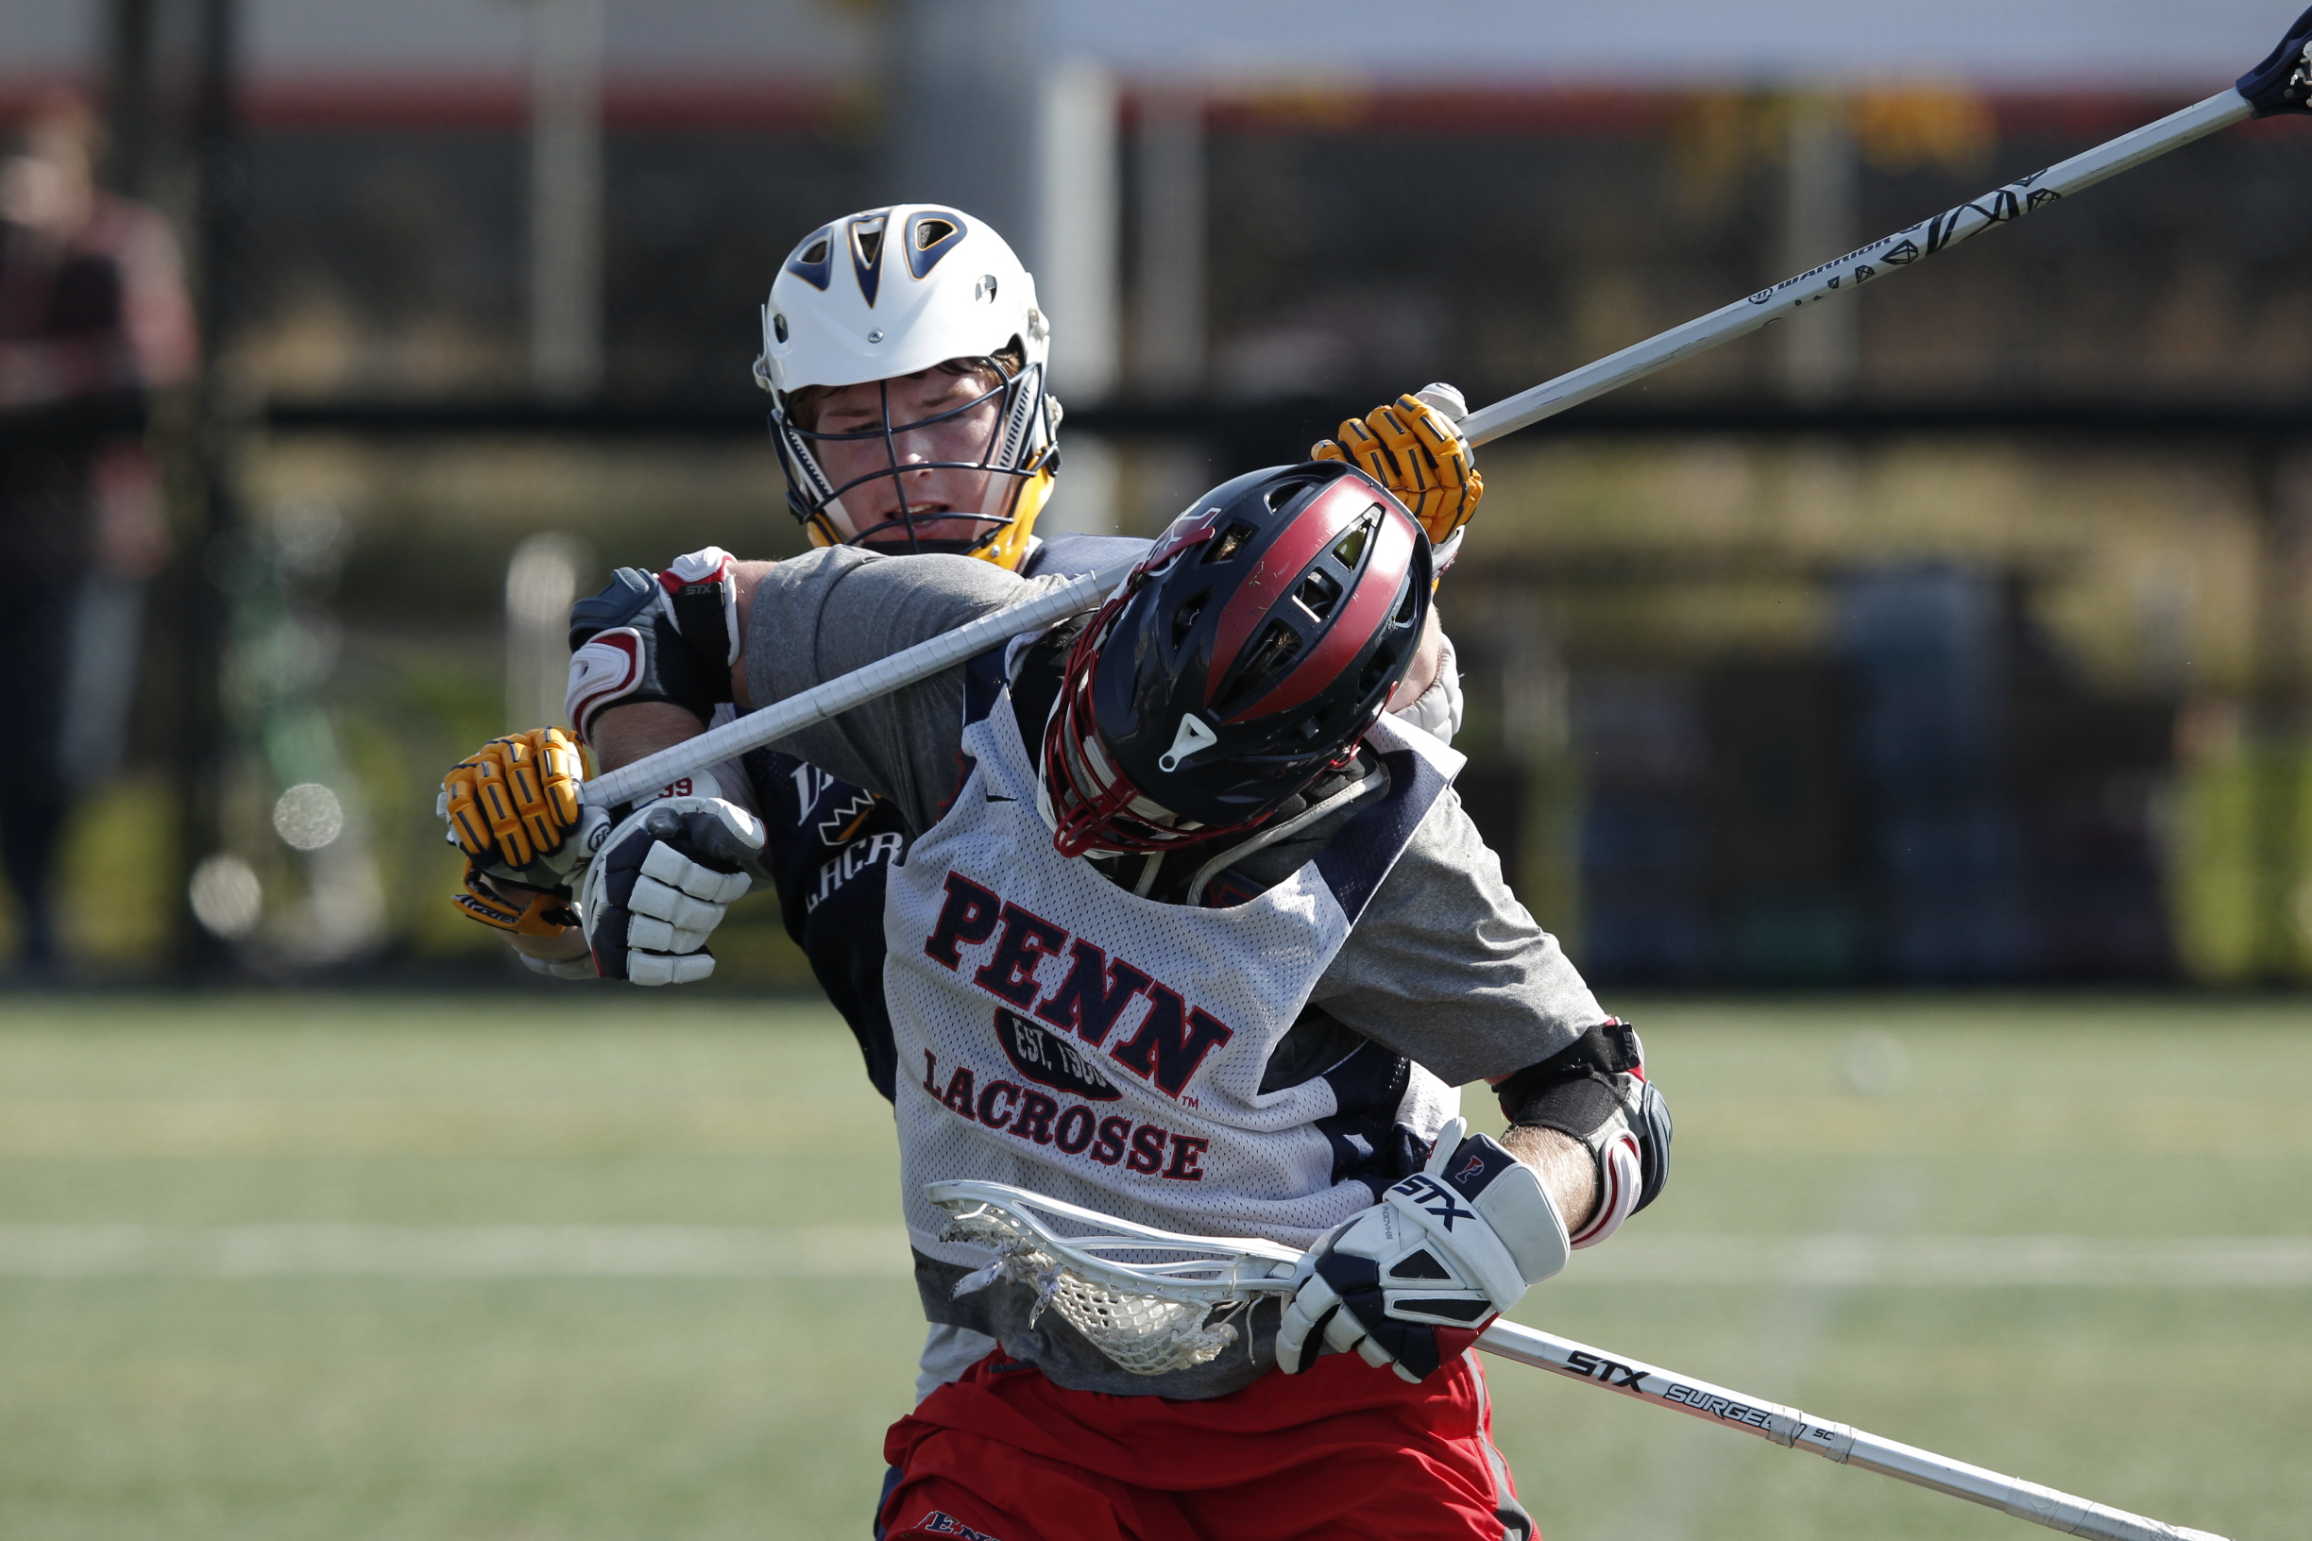
Good Officiating - ROUC
Rough
Obvious
Unnecessary
Cheap

Slide 9
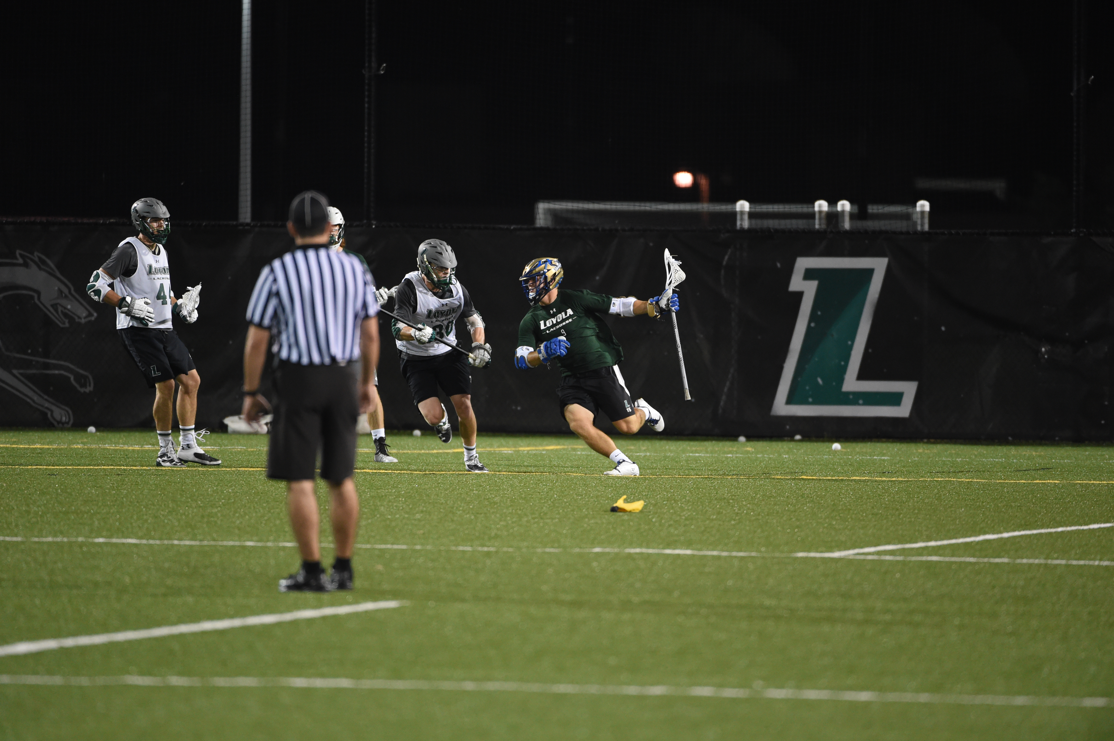
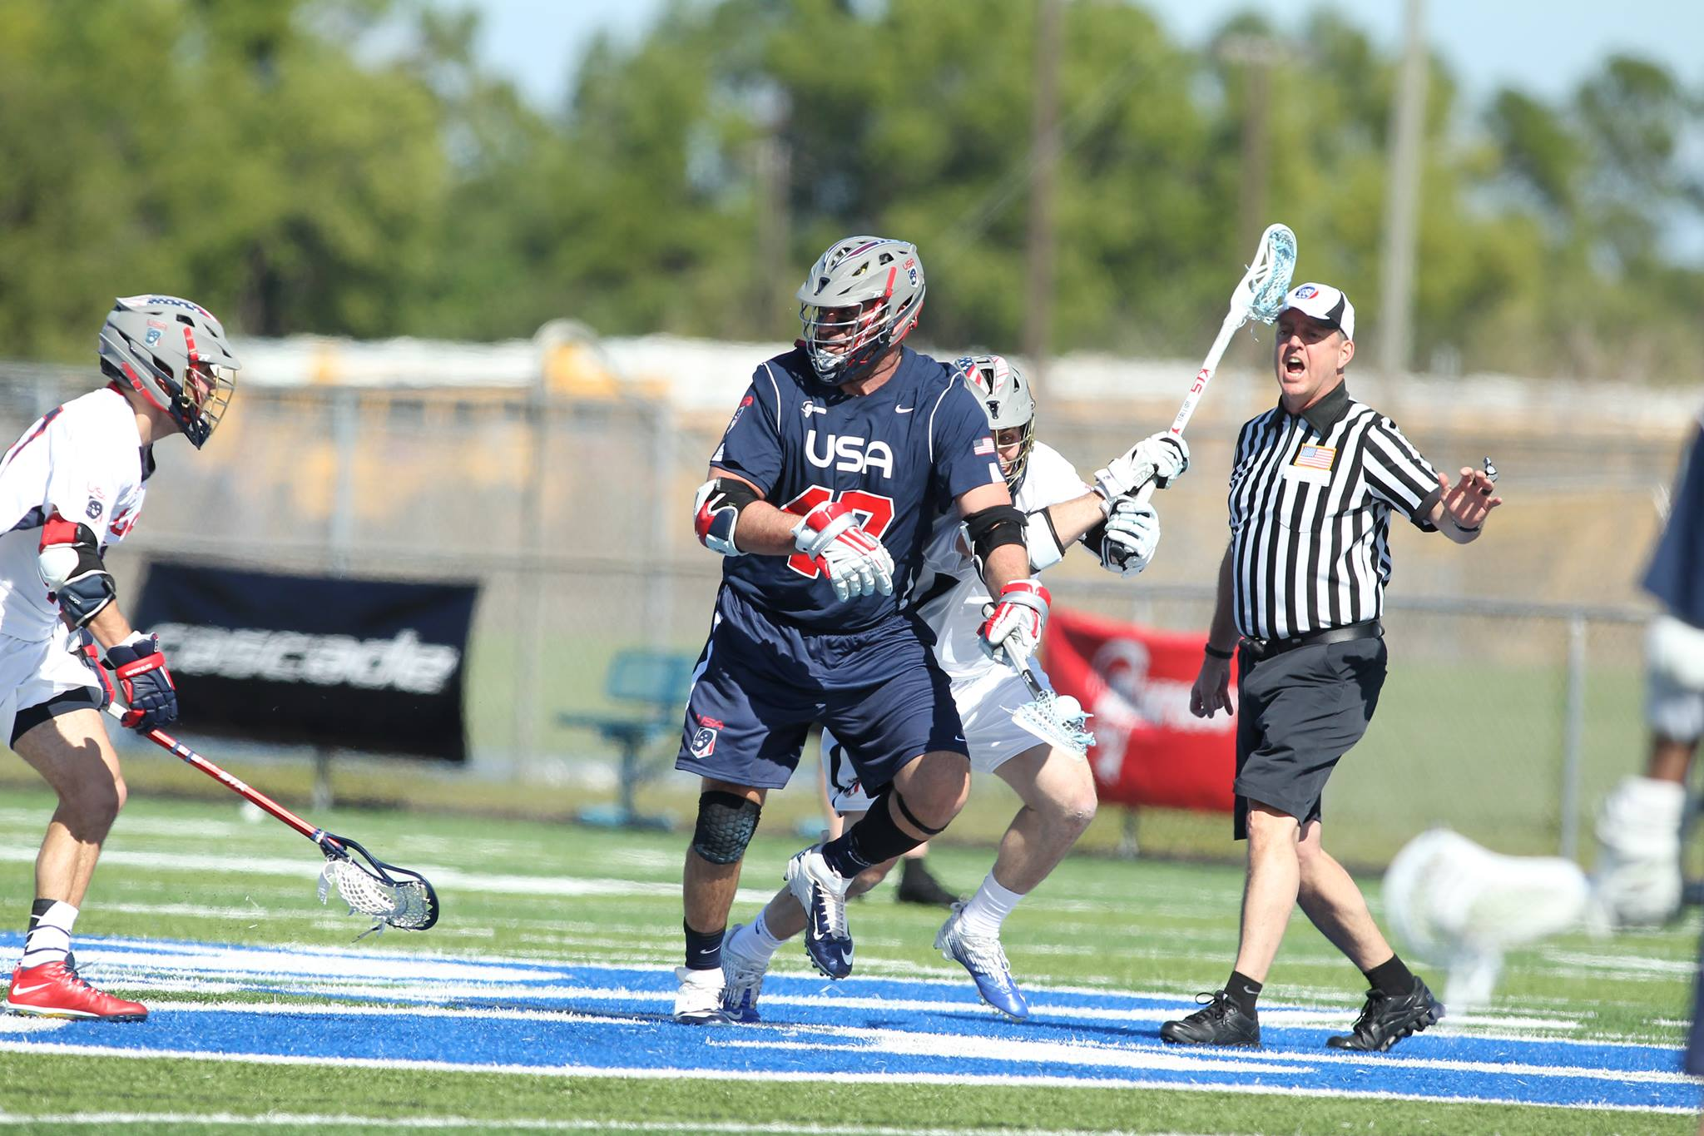
Flag v. Warning
Notes:
There is a fine line between throwing a flag and issuing a warning.
You want to call the fouls involving safety, advantage.
You also want to call the fouls certain fouls, even though there is no clear advantage
Offside away from the ball. There is a line, everyone sees it, it is obvious when a player touches or goes over
To many players away from the ball. Too many defenders? What happens if there is a change of possession and a fast break?
Try not to call fouls that provide no clear advantage.
A player steps onto the field one or two steps out of the substitution box before the other player is in the box and play is on the other side of the field.
A player is upset and cusses quietly to himself or says something to a teammate. Issue a warning, tell him to settle down.
However, don’t tolerate the F-bomb if directed inappropriately
Don’t be ticky tacky on rules. Manage the game appropriately
Most importantly – DON’T penalty hunt.
Don’t look to stick it to a kid

Slide 10


Communication – Before Game
Notes:
Before the game, the referee should email the head coach and the crew to confirm game details.
Time, Location, who the crew is, and contact information.
The referee should then send a separate email to the crew to let them know when to meet in the parking lot and any other details they need to be aware. Make sure you have all cell phone number.

Slide 11
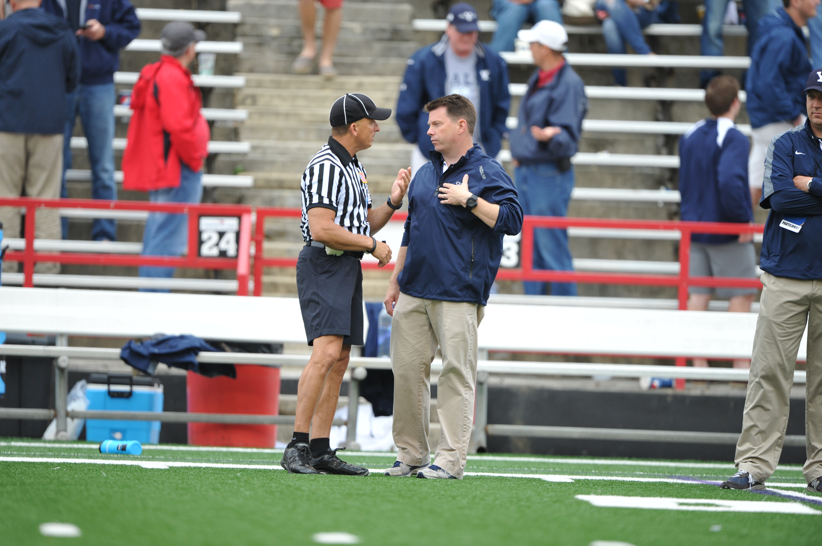

Communication – During Game (Coaches)
Notes:
During the game
Be polite, but firm with coaches and players
If a coach has a question or wants an explanation let him know that as soon there is a stoppage of play, ask him to remind you at that time to visit.
Keep in mind coaches are excitable. The louder and faster they talk, the lower and slower your should talk.
The head coach is the only one that can talk to you. If you have an issue with an assistant coach, remind the head coach that all communication should come from him.
To be overly sensitive to comments made from the stands or sidelines. Don’t have “rabbit ears”
However, if it is personal or in appropriate, handle the situation with the coach and field administrator.
Make sure you back up your crew, don’t throw them under the bus no matter how bad of a game a crew member may be having.

Slide 12
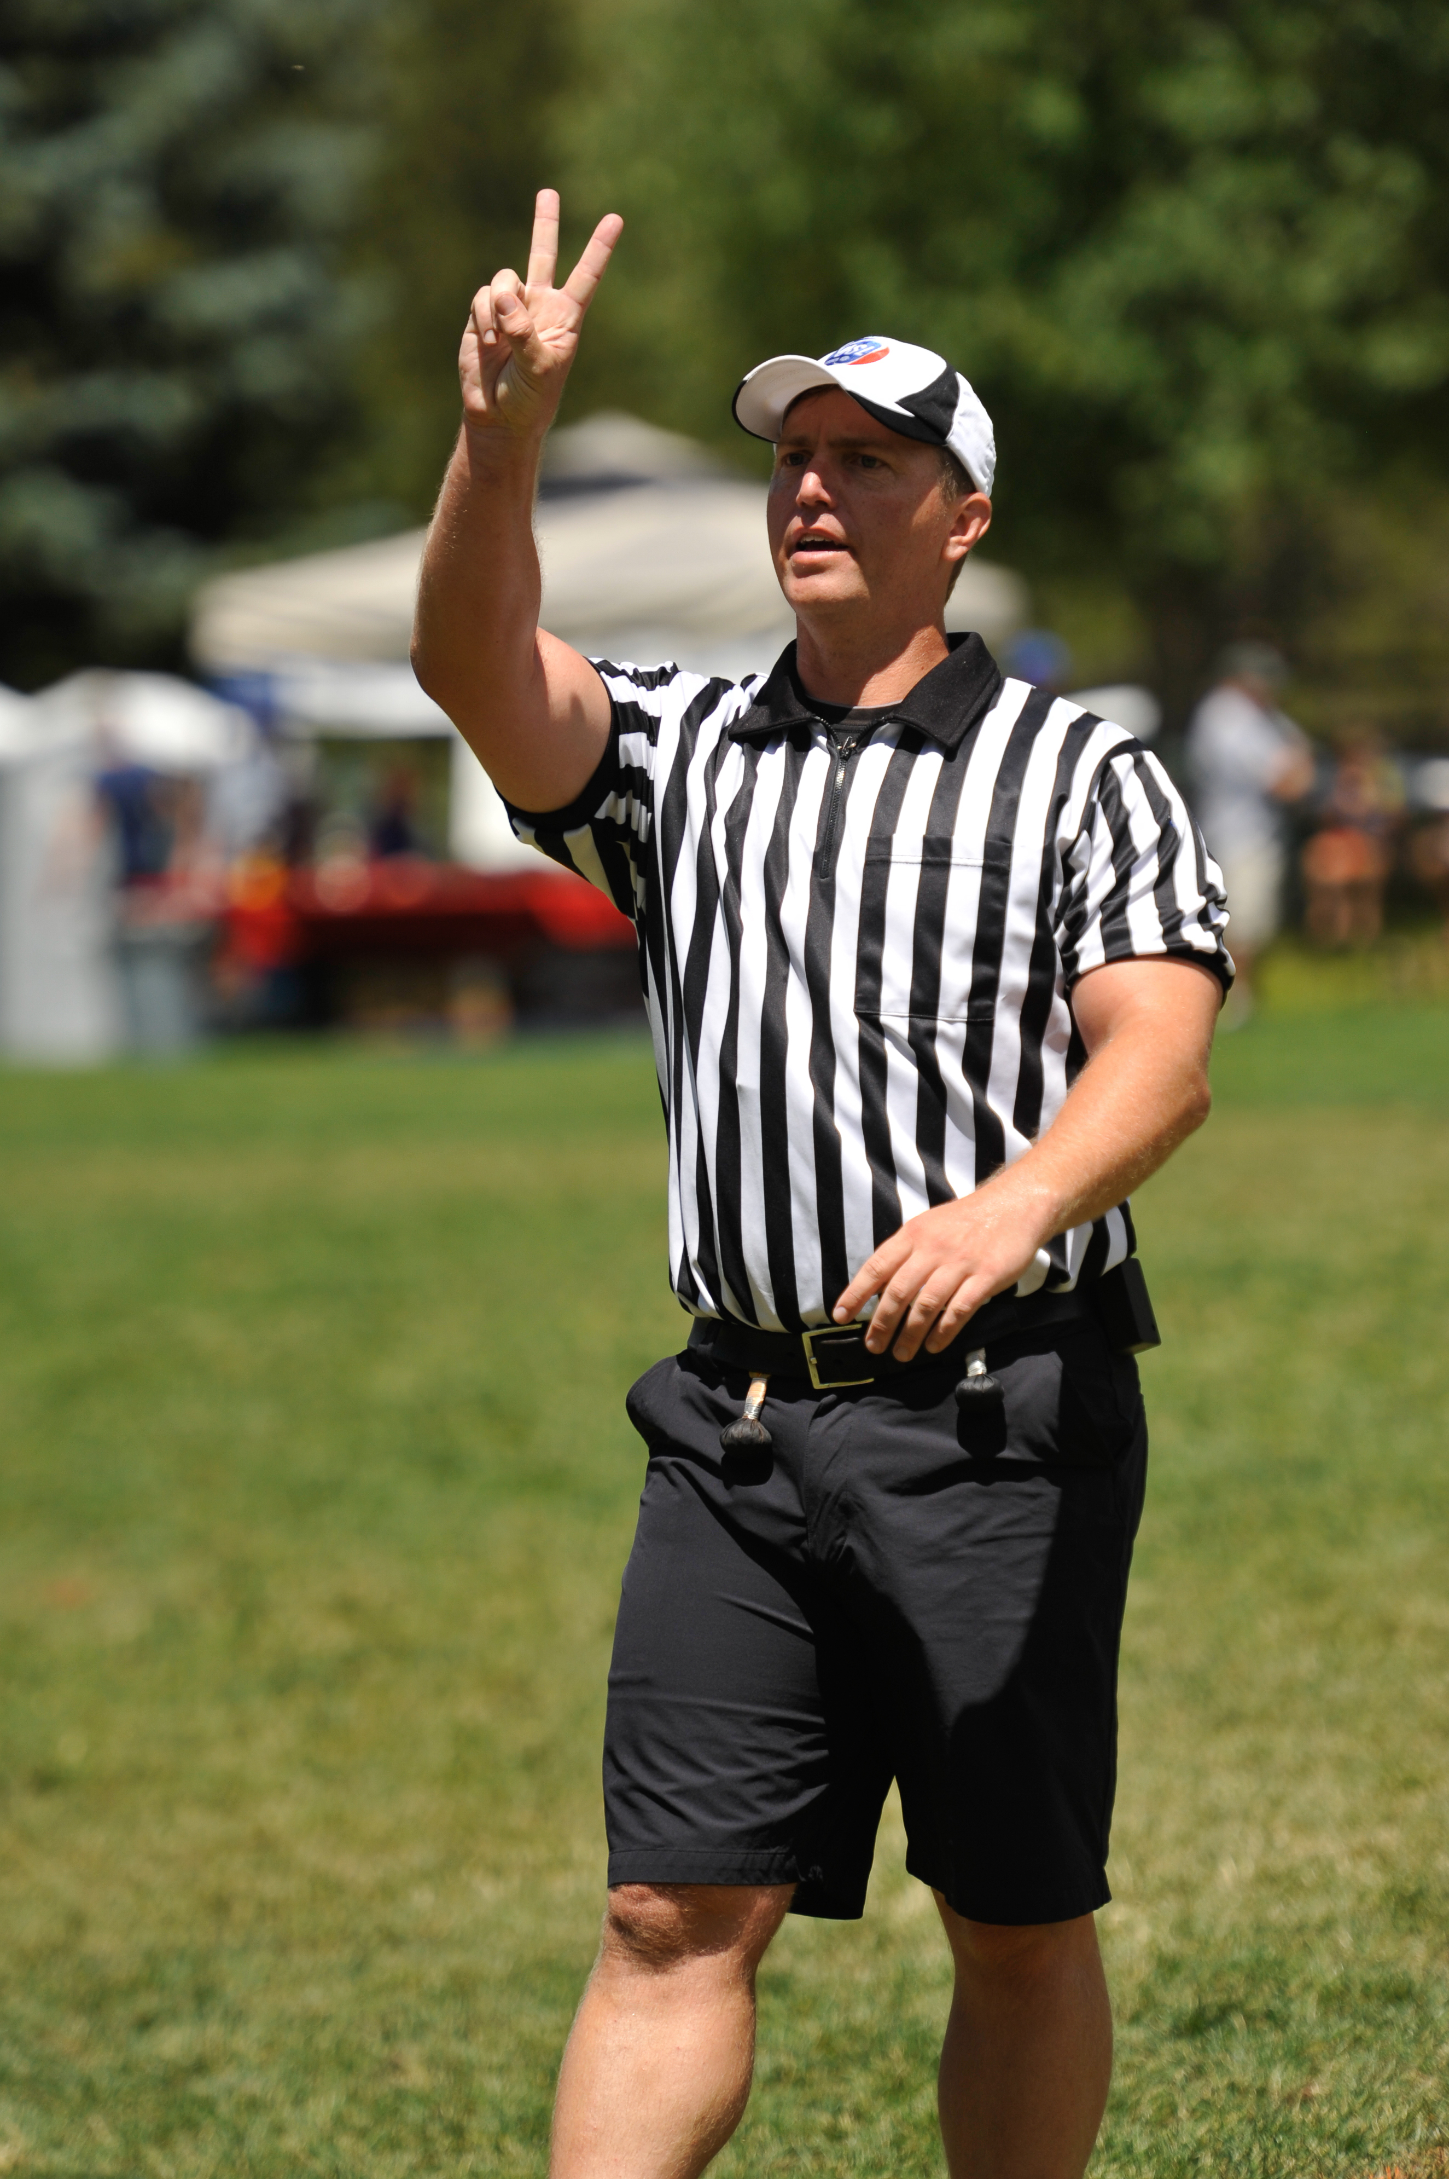
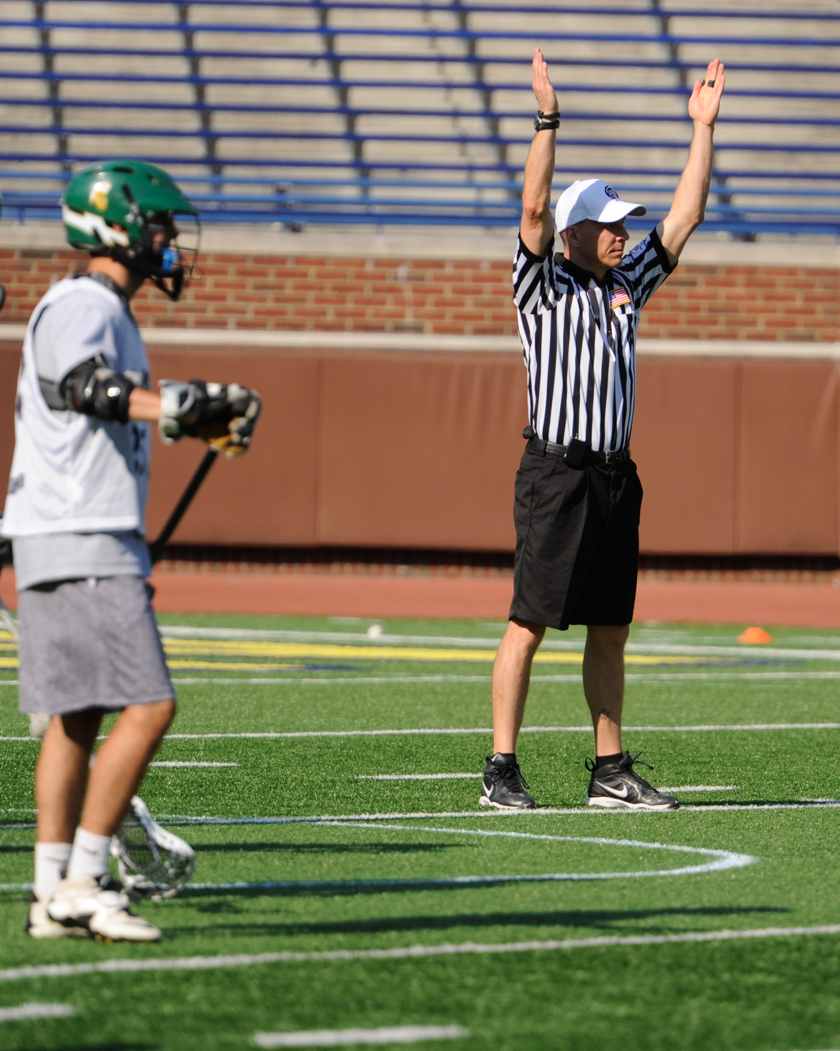
Communication – During Game (Partners)
Notes:
Communication between the officiating crew is critical.
Most of your communication will be hand signals during the game.
Make sure they are clear, visible and well done.
During time outs, quarters and halves, meet as a crew to discuss the game and important points

Slide 13
Avoid Conflict
“10% of conflicts are due to difference in opinion, the remaining 90% to the wrong tone of voice.”
Notes:
“10% of conflicts are due to difference in opinion, the remaining 90% to the wrong tone of voice.”

Slide 14
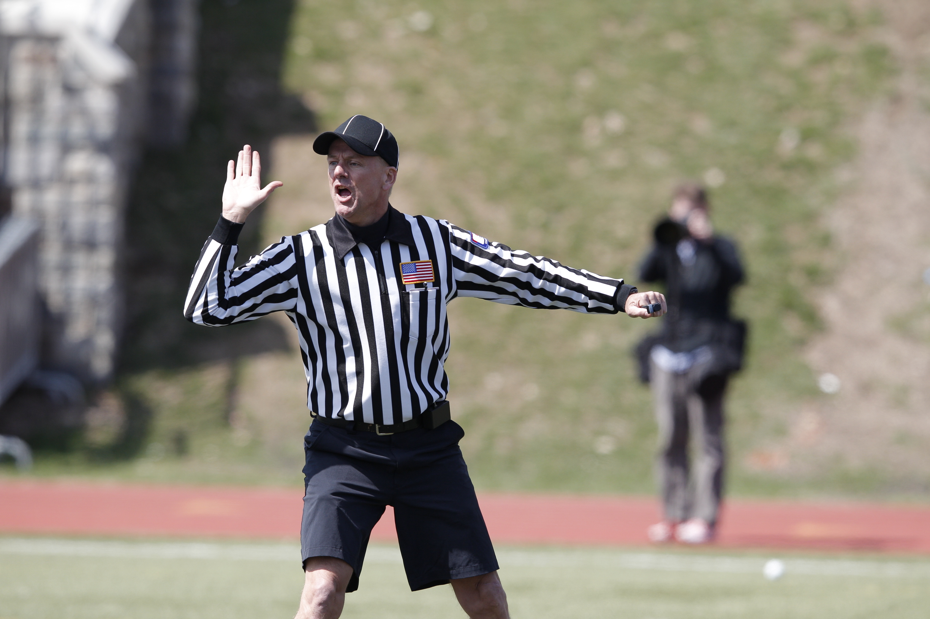
Communication – During Game (Players)
Don’t
  Coach
  Yell Angry
Do
  Be Firm
Notes:
You can often manage many game situations by talking to players during the game.
Don’t talk “too much”
Don’t coach, but manage players and situations
Don’t be too loud. Only the players should hear you. You don’t want the stands or coaches to hear you.
Don’t be a officious, but be firm. Players need to respect you and your authority.
Look for teachable moments. Players don’t know all the rules and you can help them better understand and learn from their mistakes.

Slide 15
Maintain Control
Penalize
Tell
Ask
Notes:
Manage coaches by using the Ask, Tell, Penalize escalation.
However, sometime you need to jump straight to penalize.
You should NEVER tolerate Coaches and players directing personal or inappropriate comments to you our your crew.

Slide 16
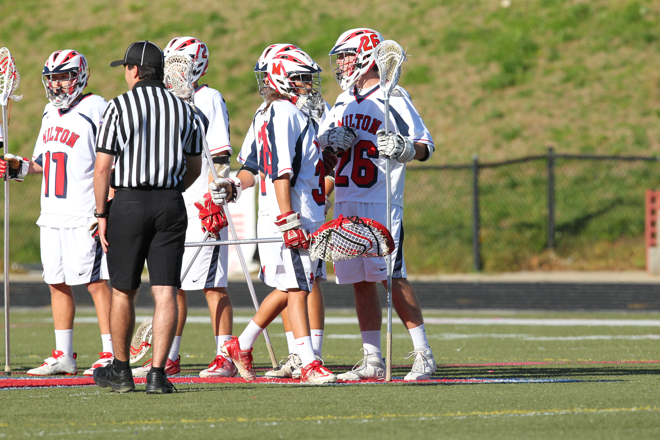
Key Point #1 – Let the Game Come to You
Notes:
Let the game come to you, don’t insert yourself into the game.

Slide 17
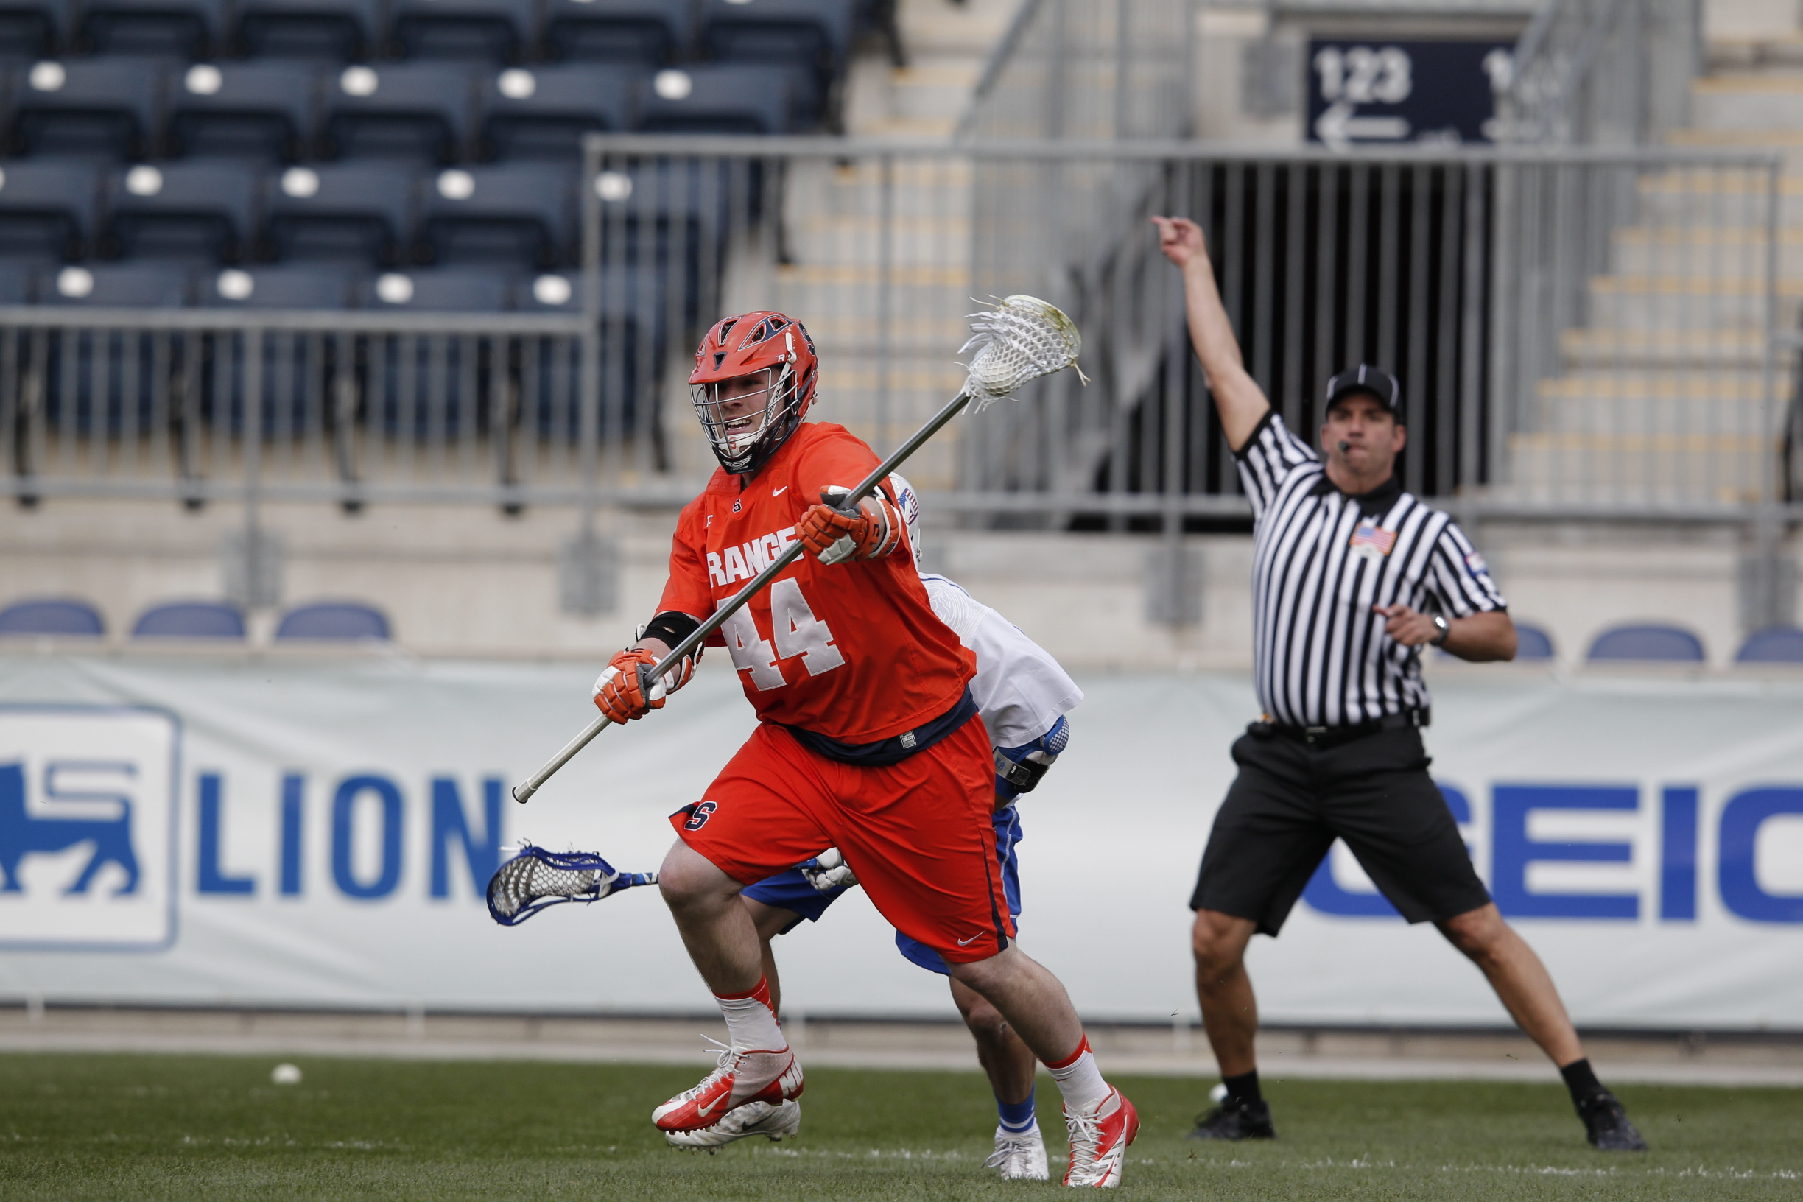
Key Point #2 - Focus
Notes:
Keep focused on the game in front of you.

Slide 18
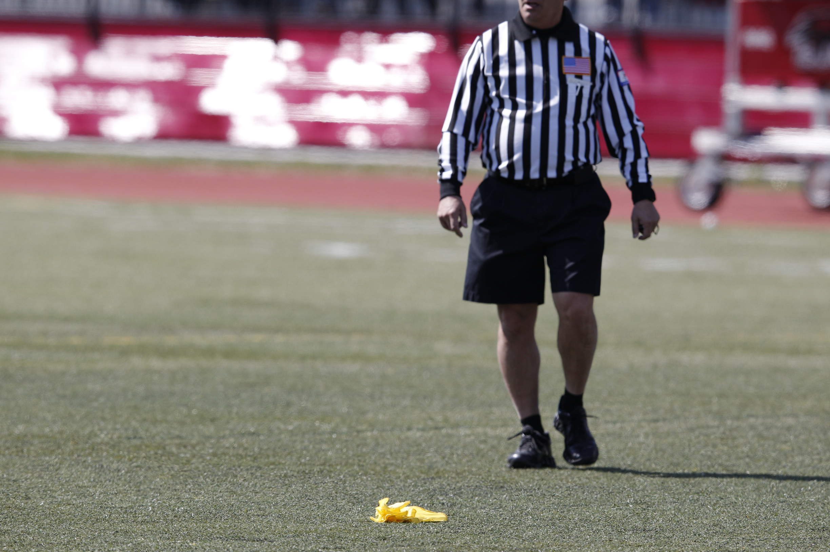
Key Point #3 – Blowout Games
Notes:
Blowout games are the worst…don’t day dream. Focus! Blowout games can get out of control as players become frustrated and angry. Cheap shots can occur.

Slide 19
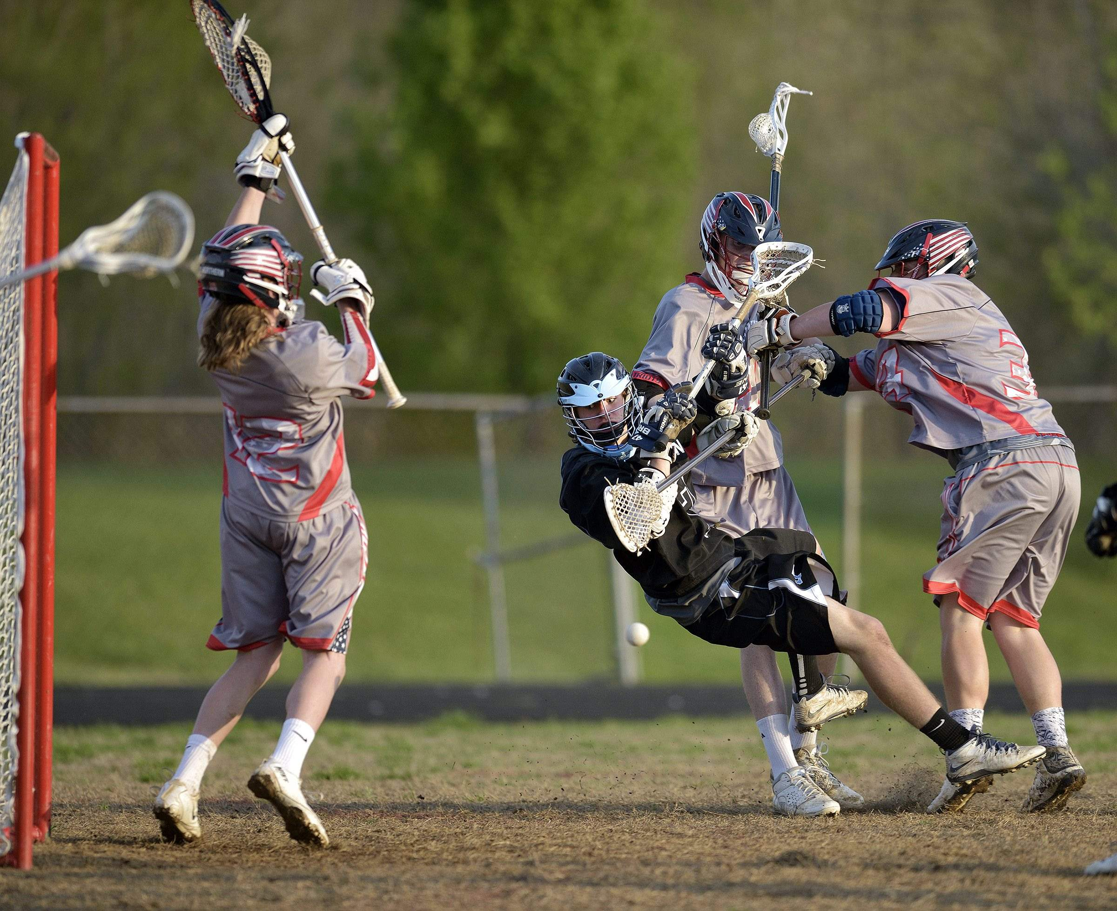
Key Point #4 – Avoid Ball Watching
Notes:
Don’t ball watch. Know to be on ball and off ball. If you are trail, follow the shooter, not the ball. You need to be able to catch the late hit or unnecessary roughness.

Slide 20
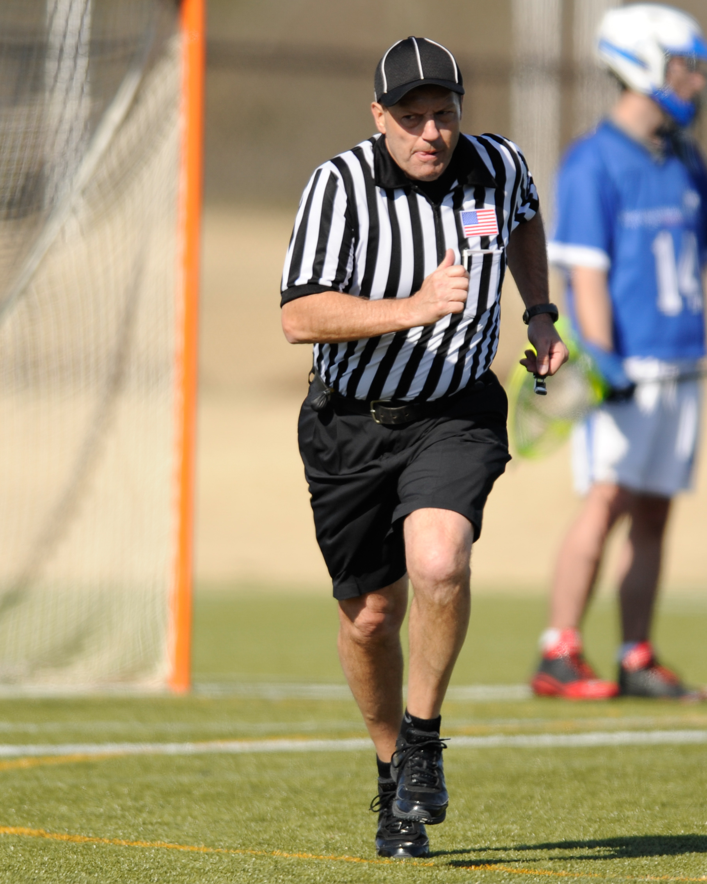
Key Point #5 – Don’t Let the Grass Die
Notes:
You need to move with the play, particularly in settled situations or when the ball is in the attack zone. Don’t let the grass die under your feet.

Slide 21
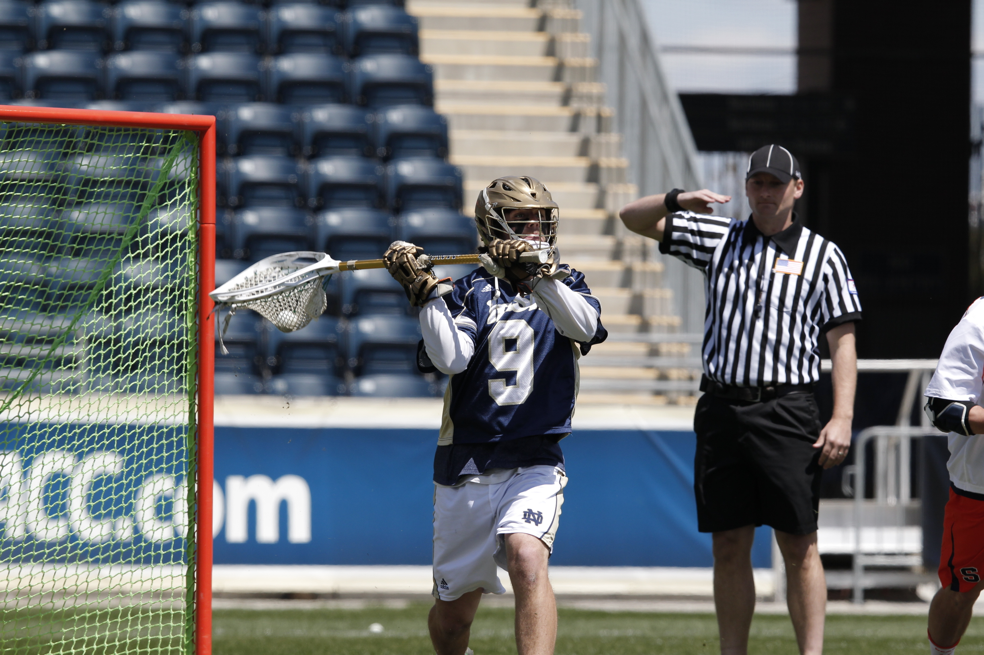
Key Point #6 – Give Your Best Effort
Notes:
It does not matter if it a youth, JV or high level varsity game, you need to give you best at all times. The coaches, players and fans expect it. Put the same effort at all levels.

Slide 22
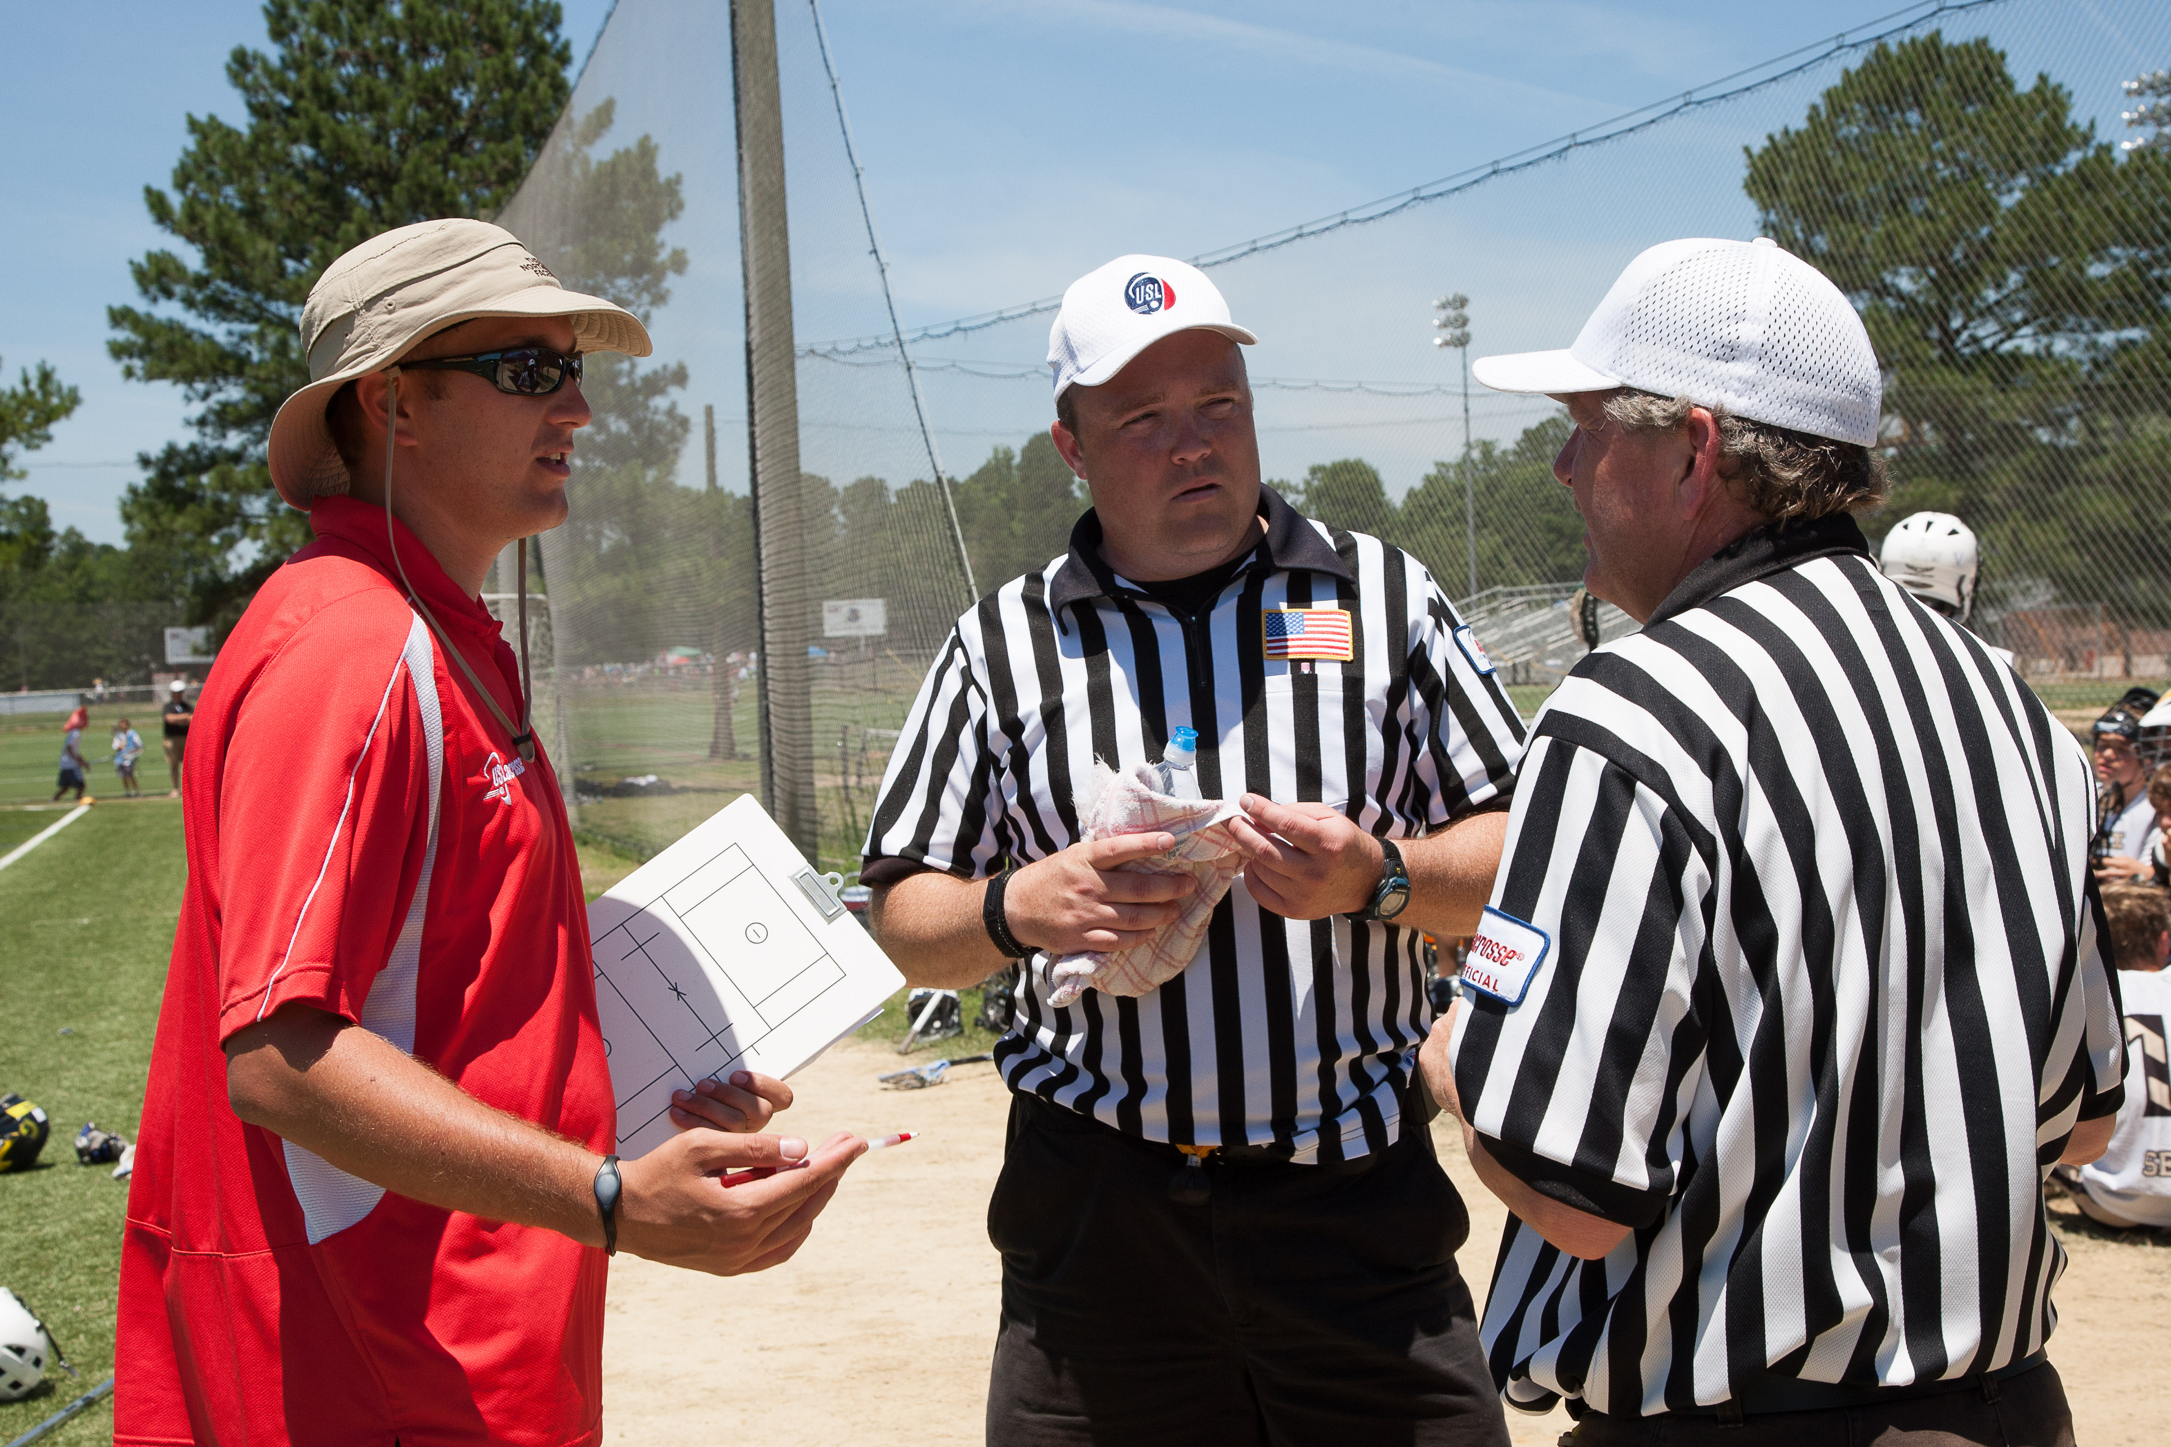
Key Point #7 – Be Open to Advice
Notes:
Be open to learning from other officials and taking constructive advice. Don’t take personal or be defensive, it will make you a better official.

Slide 23
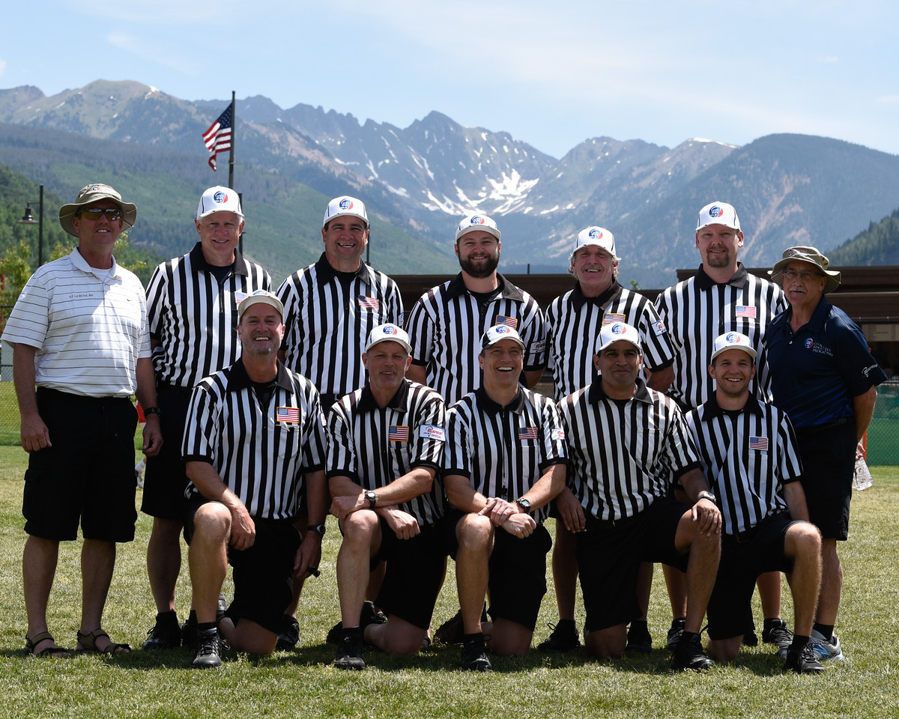
Key Tip #8 – Have Fun!
Notes:
Most important thing to keep in mind is to have fun!
(photo credit: Clark Bell, Vail Lacrosse Shootout LAREDO 3 Officials and Clinicians)

Slide 24
uslacrosse.arbitersports.com
facebook.com/menslaxofficials
Notes:
The US Lacrosse Central Hub at uslacrosse.arbitersports.com is your one stop shop for men’s officiating memos, articles, videos, downloadable resources, and rules tests. You can also find applications to this year’s LAREDO clinics.
Follow the Men’s Officials Education Program on Facebook at facebook.com/menslaxofficials

